Slide 1
Meeting on June 6
Takumi Shiota
June 6, 2025
@Maastricht univ.

Slide 2
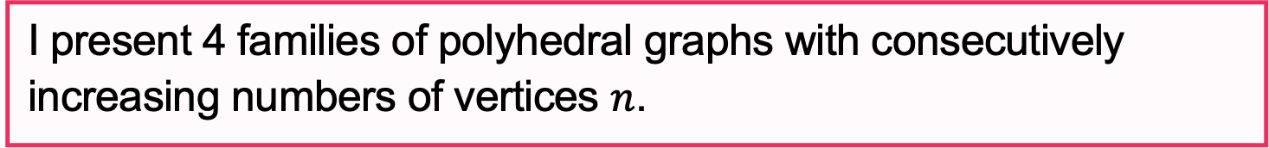
Progress report
Program flow
Enumerate non-isomorphic, connected graphs with minimum degree at least 3 using Nauty
Remove non-planar graphs (Boost (c++))
Remove graphs that are not 3-connected (NetworkX)
Apply degree constraints (NetworkX)
Draw and save the graphs (NetworkX)
Today’s report
I present 4 families of polyhedral graphs with consecutively increasing numbers of vertices $n$.

Slide 3
List of obtained [deg., cnt.] sequences
Sequence 1
Sequence 2
n=6: [3,3][4,2][5,1]
n=7: [3,4][4,2][6,1]
n=8: [3,5][4,2][7,1]
n=9: [3,6][4,2][8,1]
n=10: [3,7][4,2][9,1]
n=11: [3,8][4,2][10,1]
n=7: [3,6][4,1]
n=8: [3,7][5,1]
n=9: [3,8][6,1]
n=10: [3,9][7,1]
n=11: [3,10][8,1]
Sequence 3
Sequence 4
n=7: [3,3][4,3][5,1]
n=8: [3,4][4,3][6,1]
n=9: [3,5][4,3][7,1]
n=10: [3,6][4,3][8,1]
n=11: [3,7][4,3][9,1]
n=7: [3,1][4,5][5,1]
n=8: [3,2][4,5][6,1]
n=9: [3,3][4,5][7,1]
n=10: [3,4][4,5][8,1]
n=11: [3,5][4,5][9,1]

Slide 4
List of obtained [deg., cnt.] sequences
Sequence 5
Sequence 6
n=7: [3,2][4,2][5,2][6,1]
n=8: [3,3][4,2][5,2][7,1] n=9: [3,4][4,2][5,2][8,1] n=10: [3,5][4,2][5,2][9,1]
n=11: [3,6][4,2][5,2][10,1]
n=7: [3,2][4,4][6,1]
n=8: [3,3][4,4][7,1]
n=9: [3,4][4,4][8,1]
n=10: [3,5][4,4][9,1]
n=11: [3,6][4,4][10,1]
Sequence 7
Sequence 8
n=7: [3,3][5,3][6,1]
n=8: [3,4][5,3][7,1]
n=9: [3,5][5,3][8,1]
n=10: [3,6][5,3][9,1]
n=11: [3,7][5,3][10,1]
n=7: [3,2][4,2][5,2][6,1]
n=8: [3,2][4,2][5,3][7,1]
n=9: [3,2][4,2][5,4][8,1]
n=10: [3,2][4,2][5,5][9,1]
n=11: [3,2][4,2][5,6][10,1]

Slide 5
List of obtained [deg., cnt.] sequences
Sequence 24
Sequence 25
n=6: [3,3][4,2][5,1]
n=8: [3,3][4,4][7,1]
n=10: [3,3][4,6][9,1]
n=6: [3,4][4,2]
n=8: [3,6][5,2]
n=10: [3,8][6,2]
Sequence 26
Sequence 27
n=7: [3,3][4,3][5,1]
n=9: [3,3][4,5][7,1]
n=11: [3,3][4,7][9,1]
n=7: [3,2][4,3][5,2]
n=9: [3,4][4,3][6,2]
n=11: [3,6][4,3][7,2]
Sequence 28
Sequence 29
n=7: [3,4][4,1][5,2]
n=9: [3,4][4,3][6,2]
n=11: [3,4][4,5][7,2]
n=7: [3,4][4,1][5,2]
n=9: [3,6][4,1][6,2]
n=11: [3,8][4,1][7,2]

Slide 6
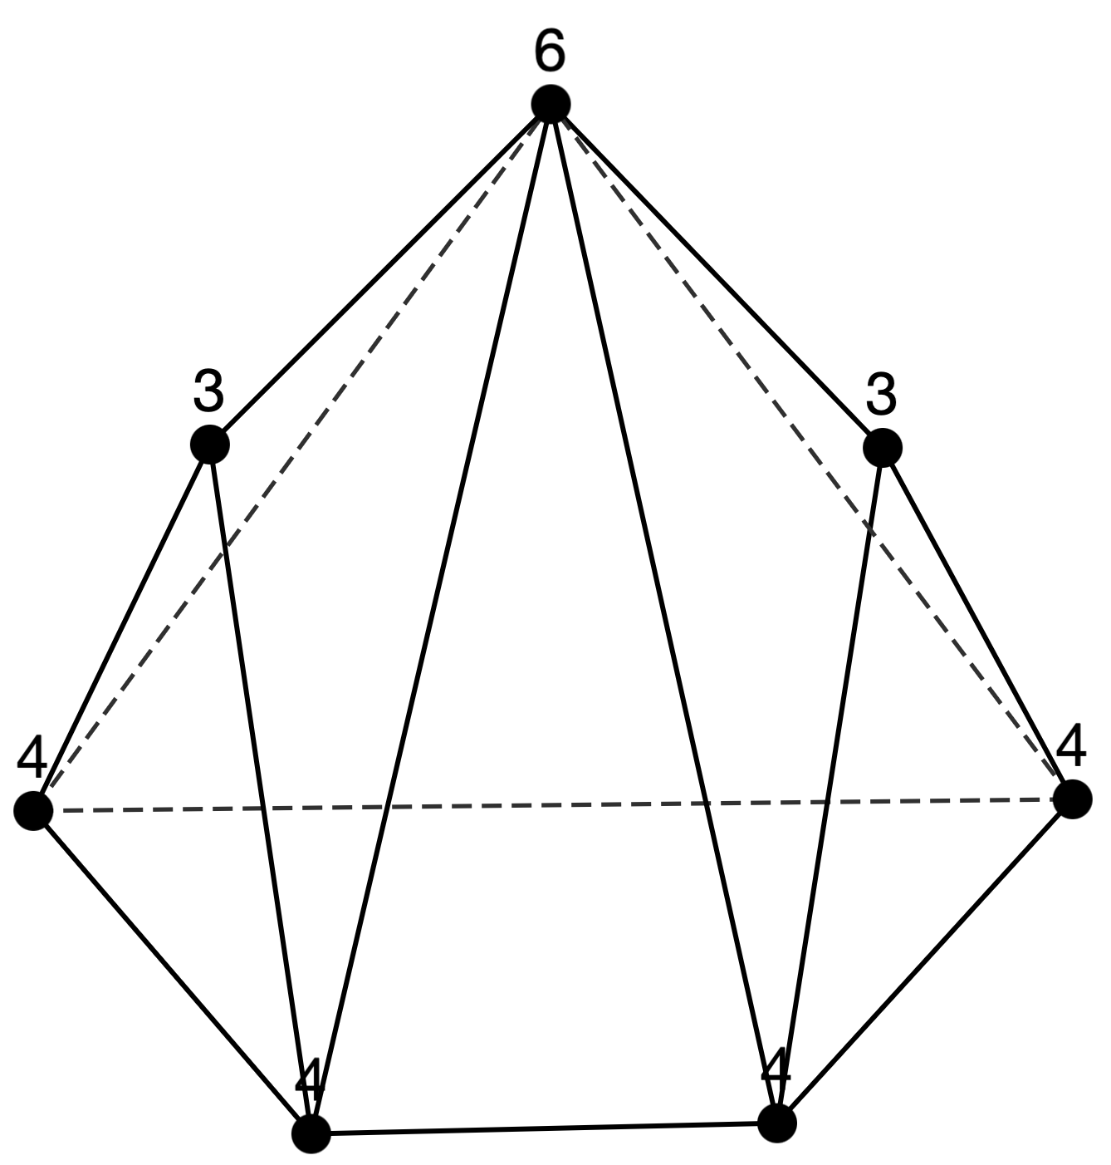
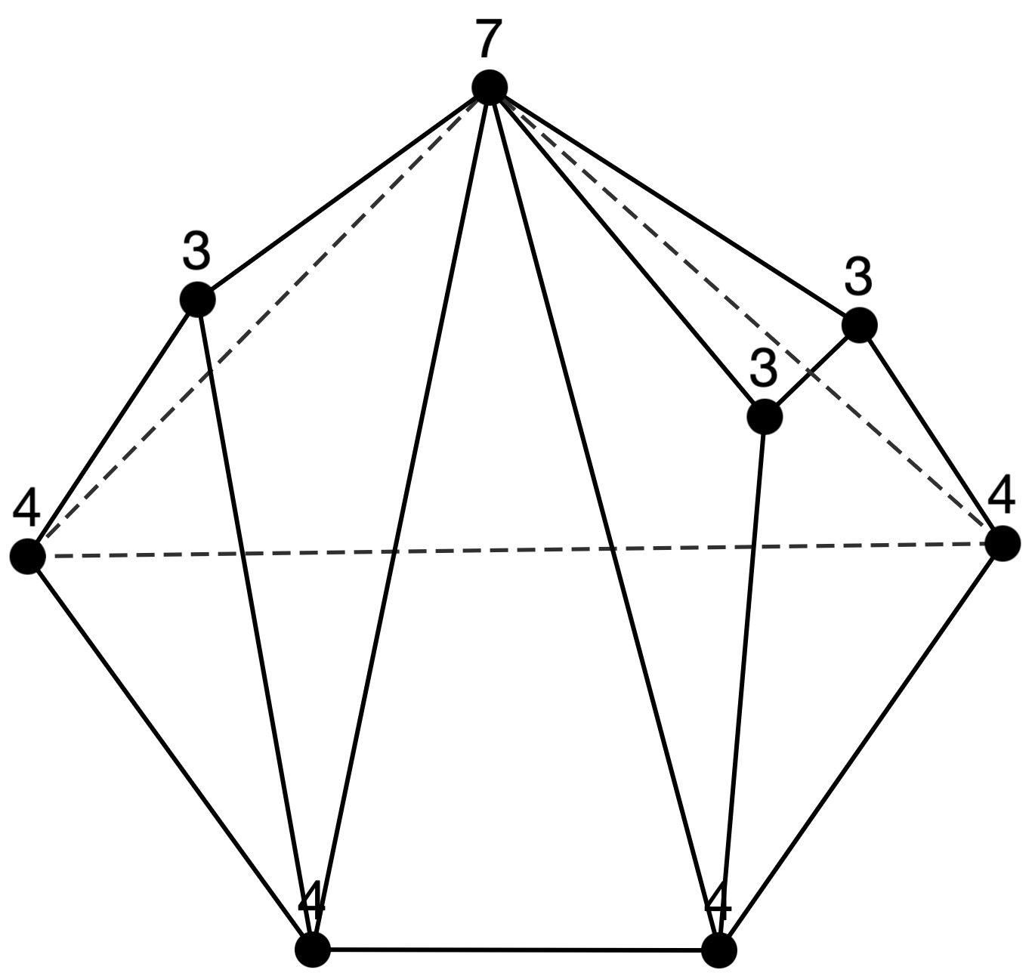
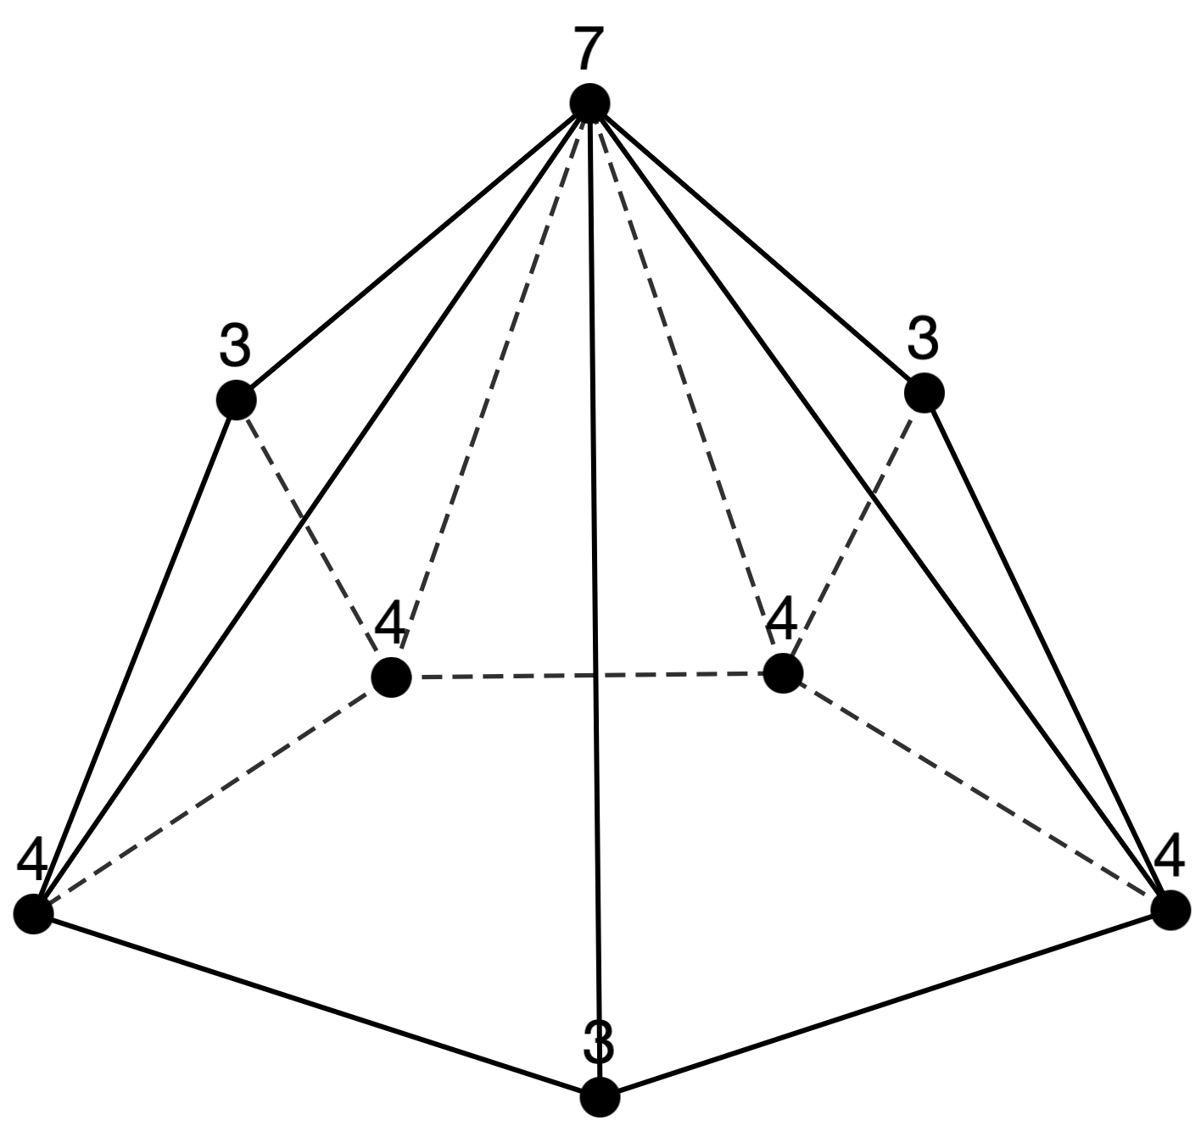
Sequence 6
n=7: [3,2][4,4][6,1]
n=8: [3,3][4,4][7,1]
n=9: [3,4][4,4][8,1]
n=10: [3,5][4,4][9,1]
n=11: [3,6][4,4][10,1]
n = 7 (1 type)
n = 8 (2 types)

Slide 7
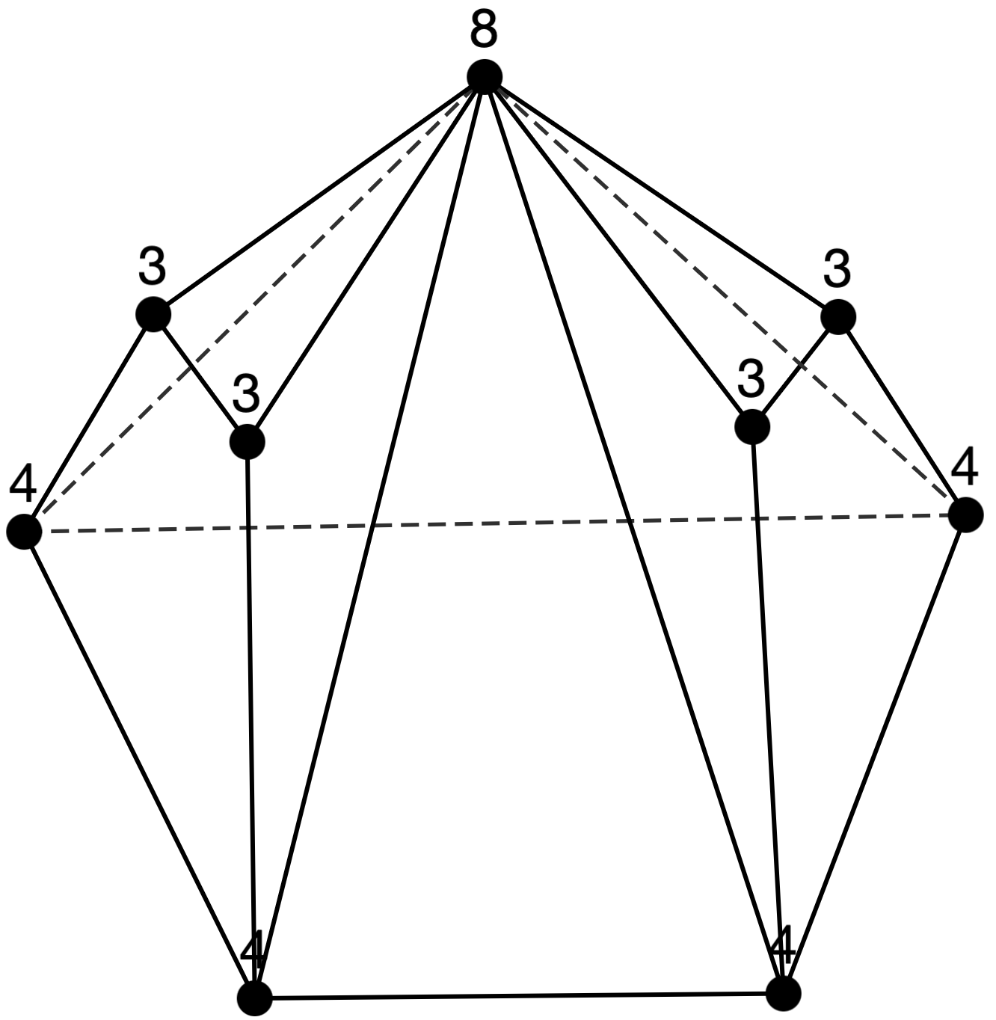
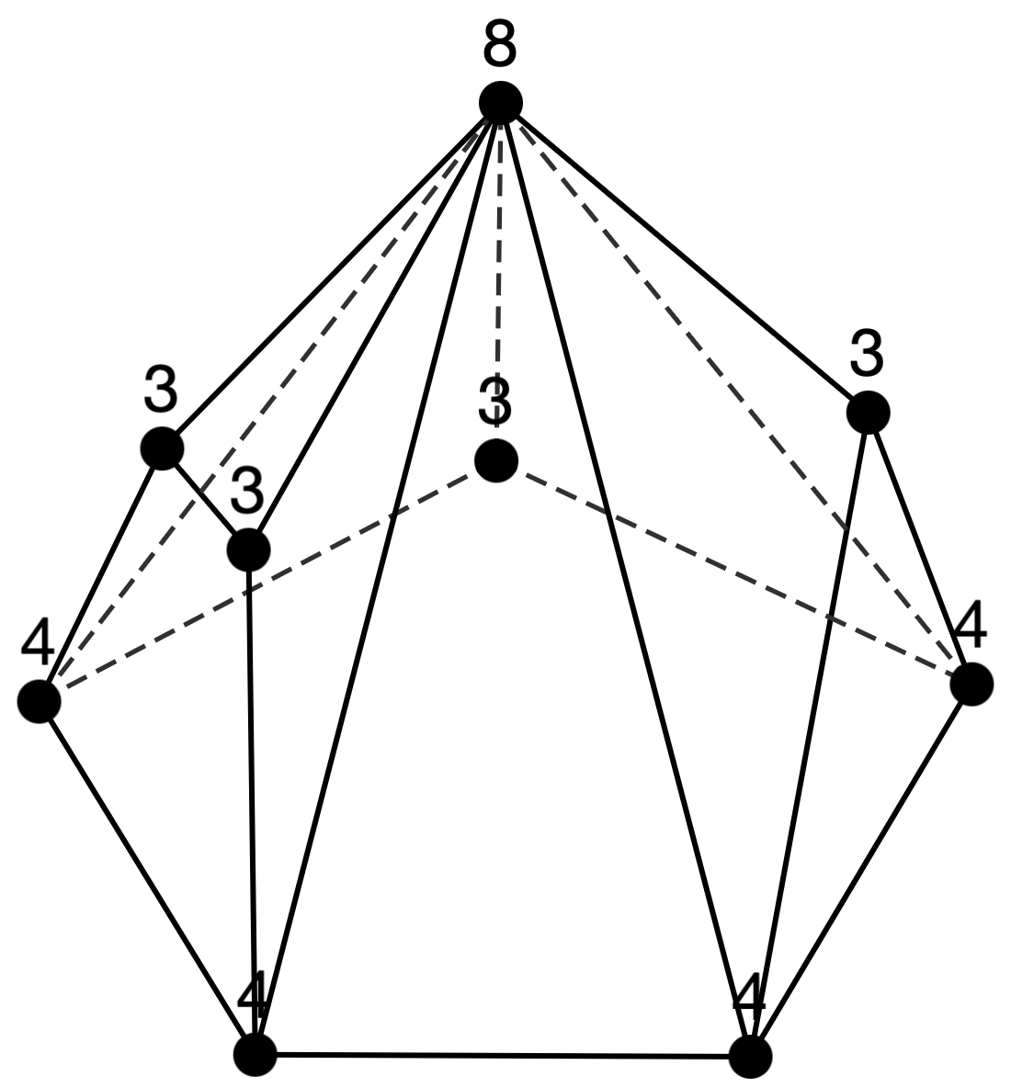
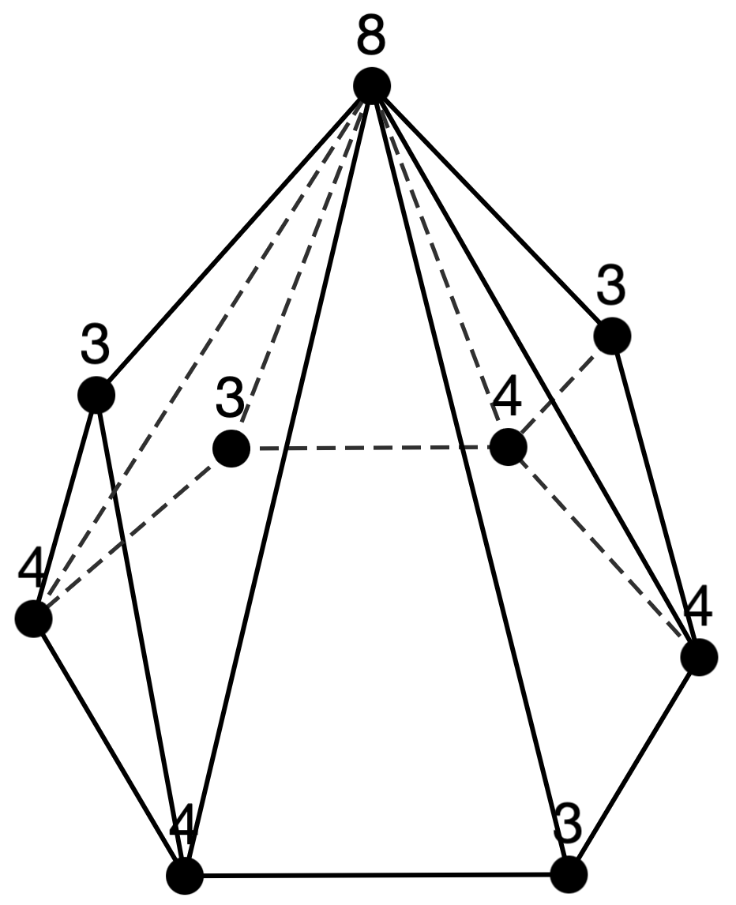
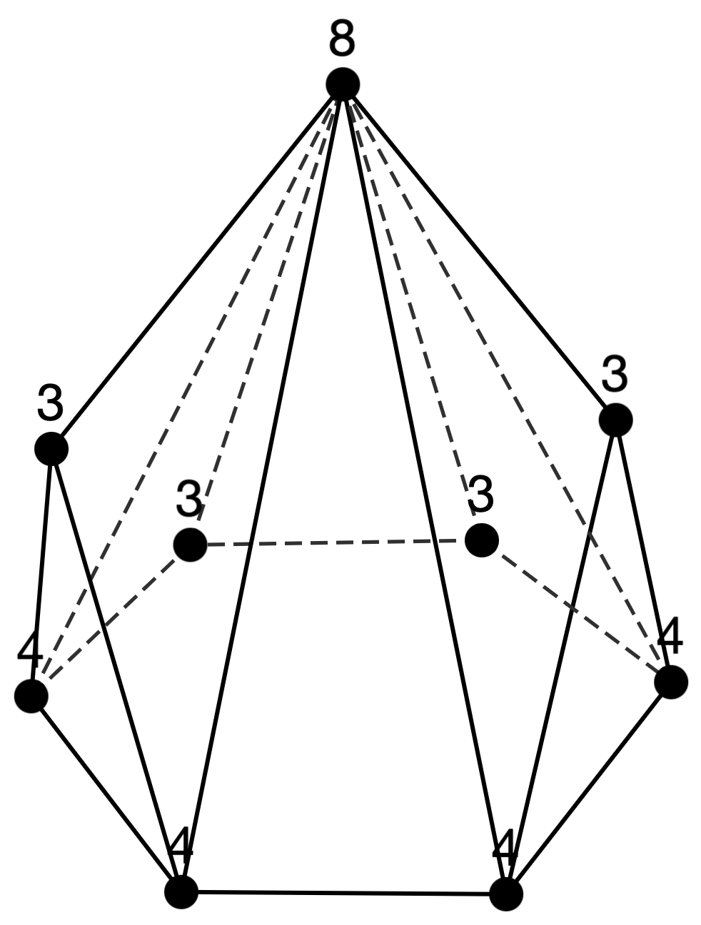
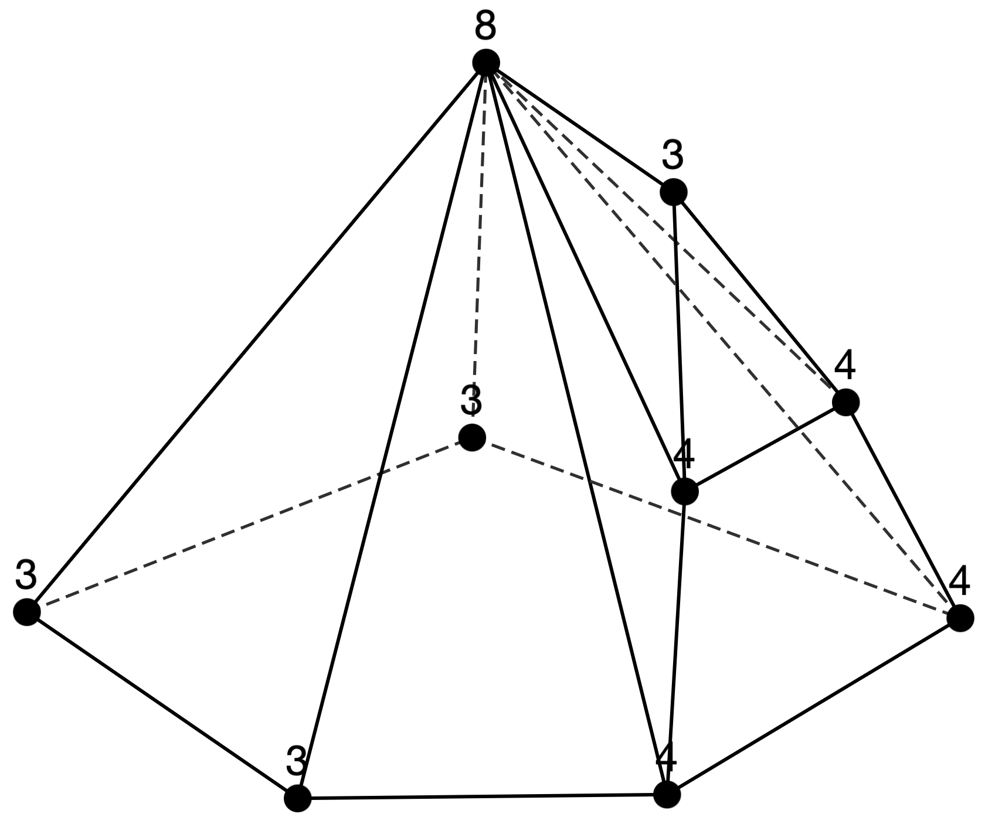
Sequence 6
n = 9 (5 types)

Slide 8
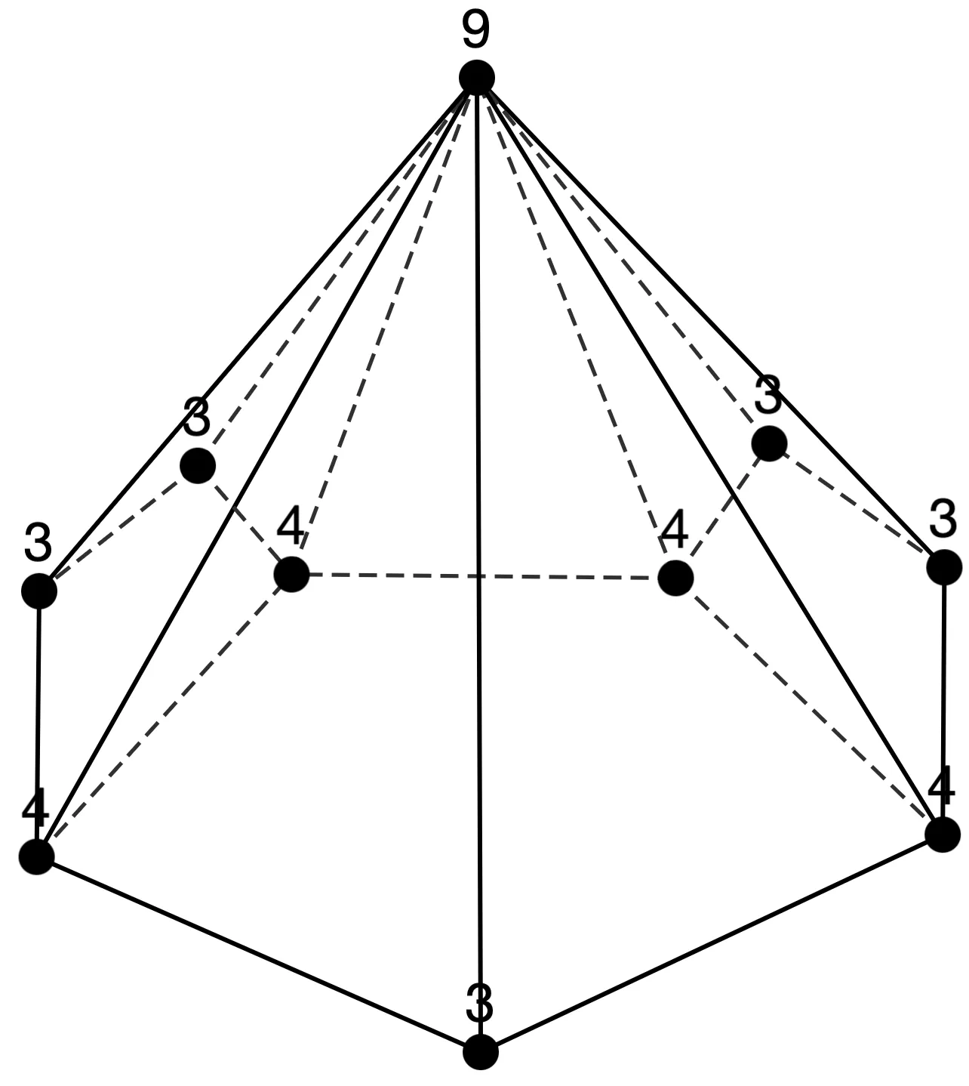
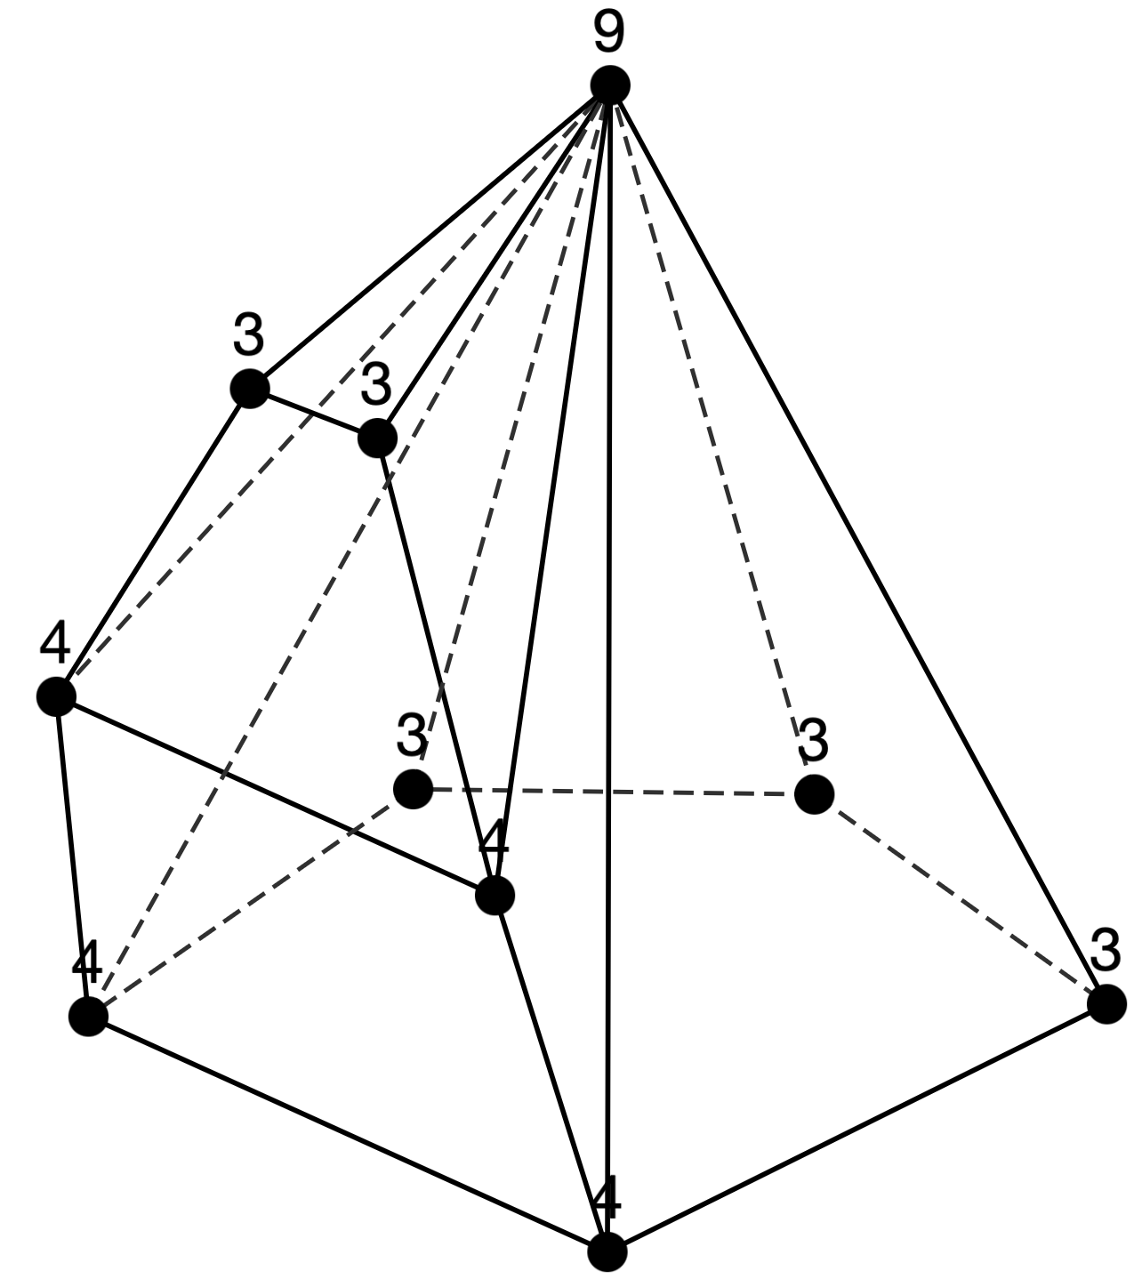
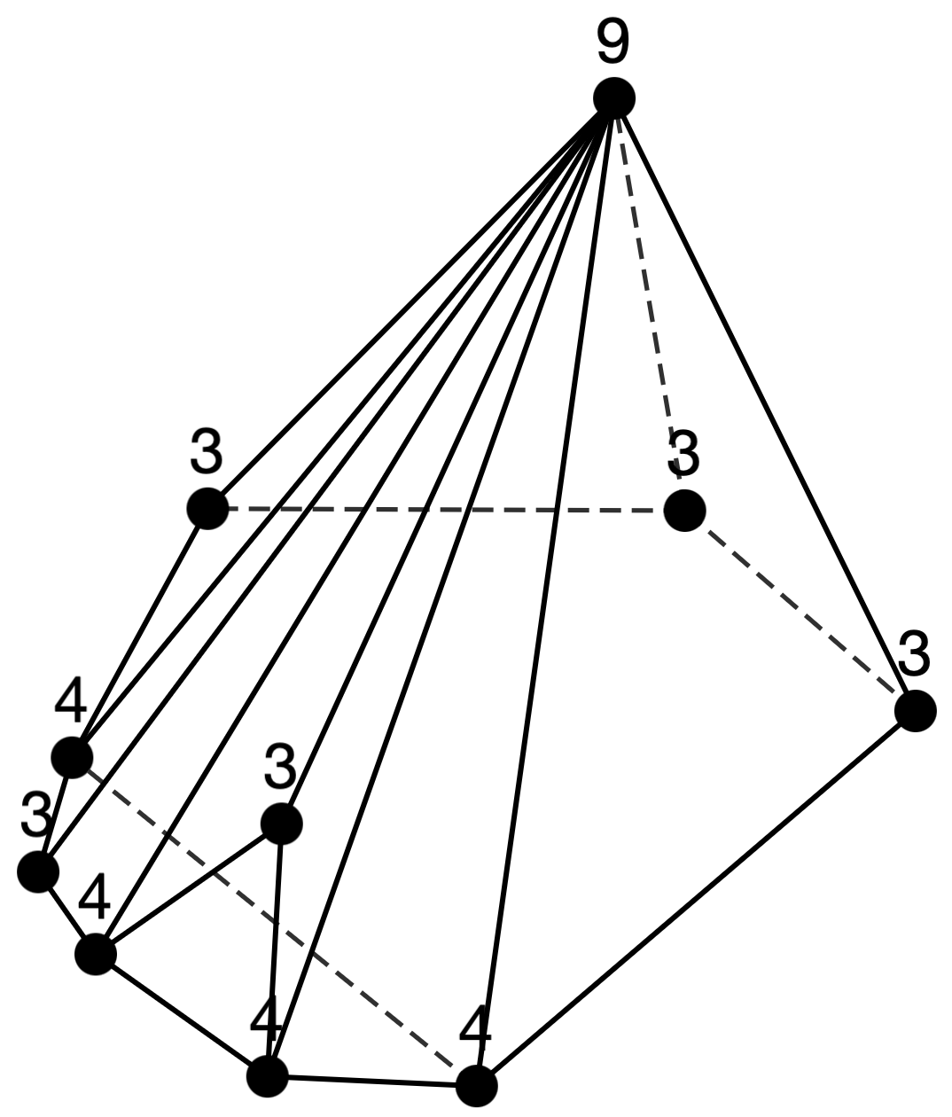
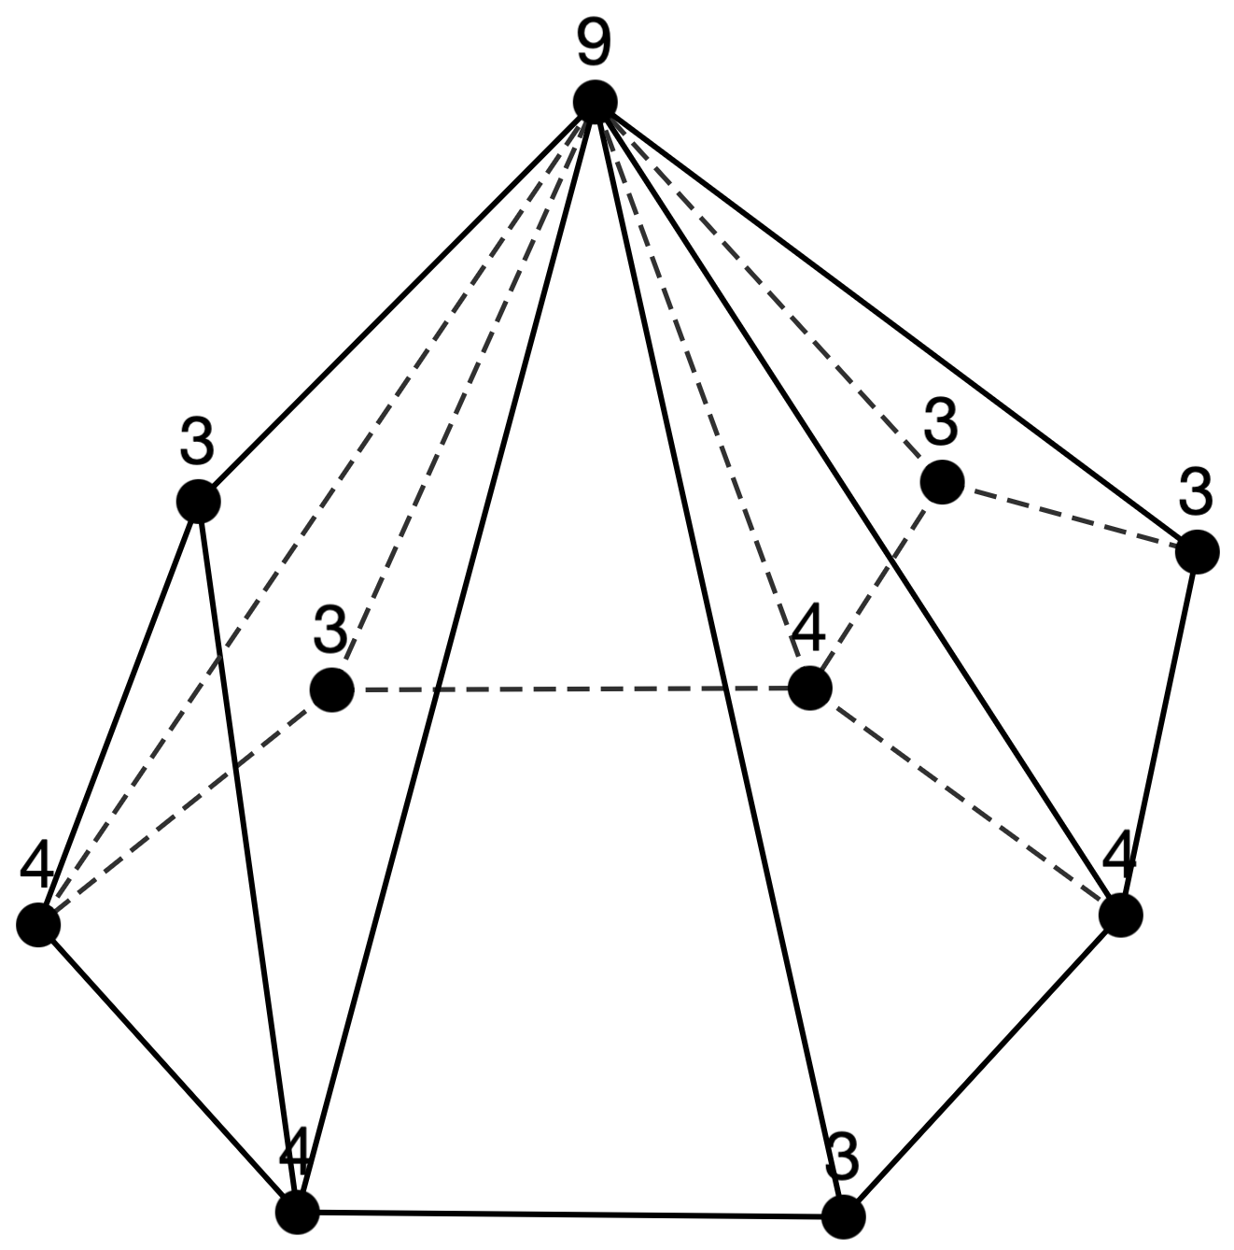
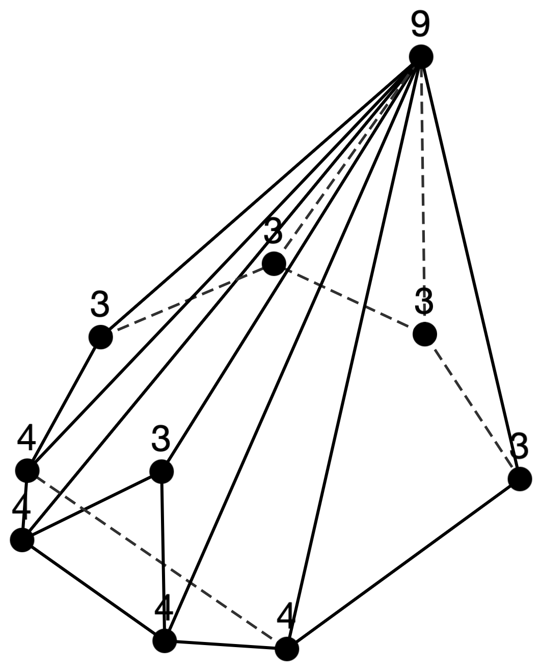
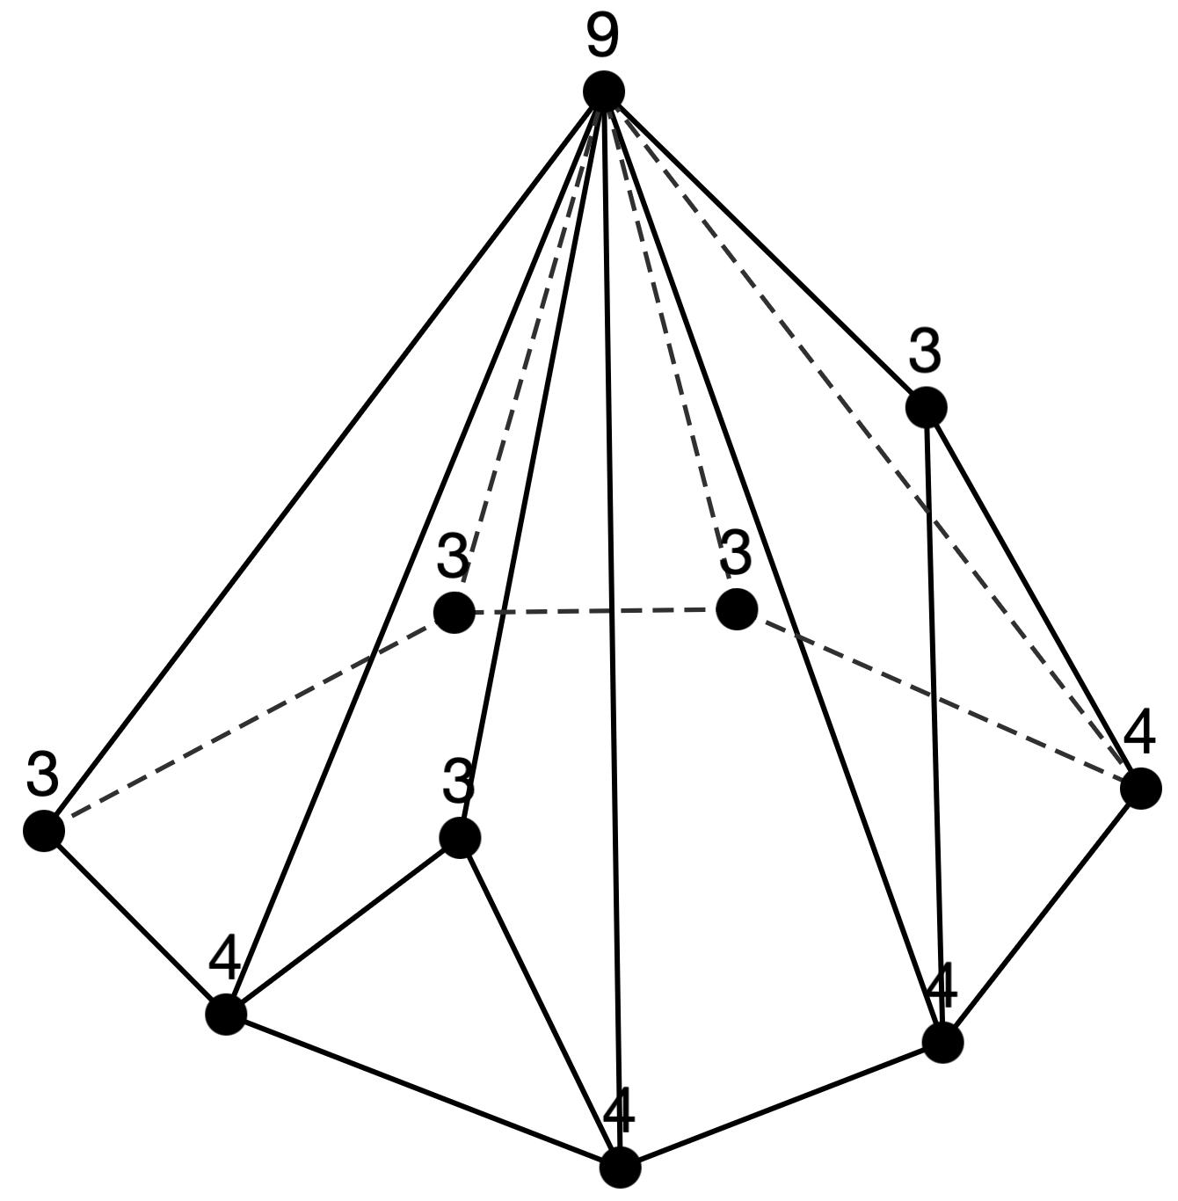
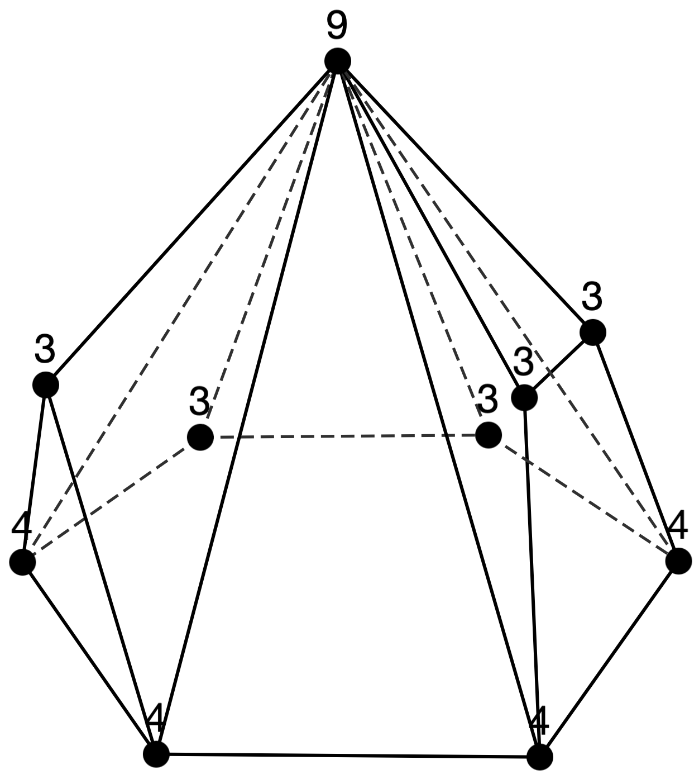
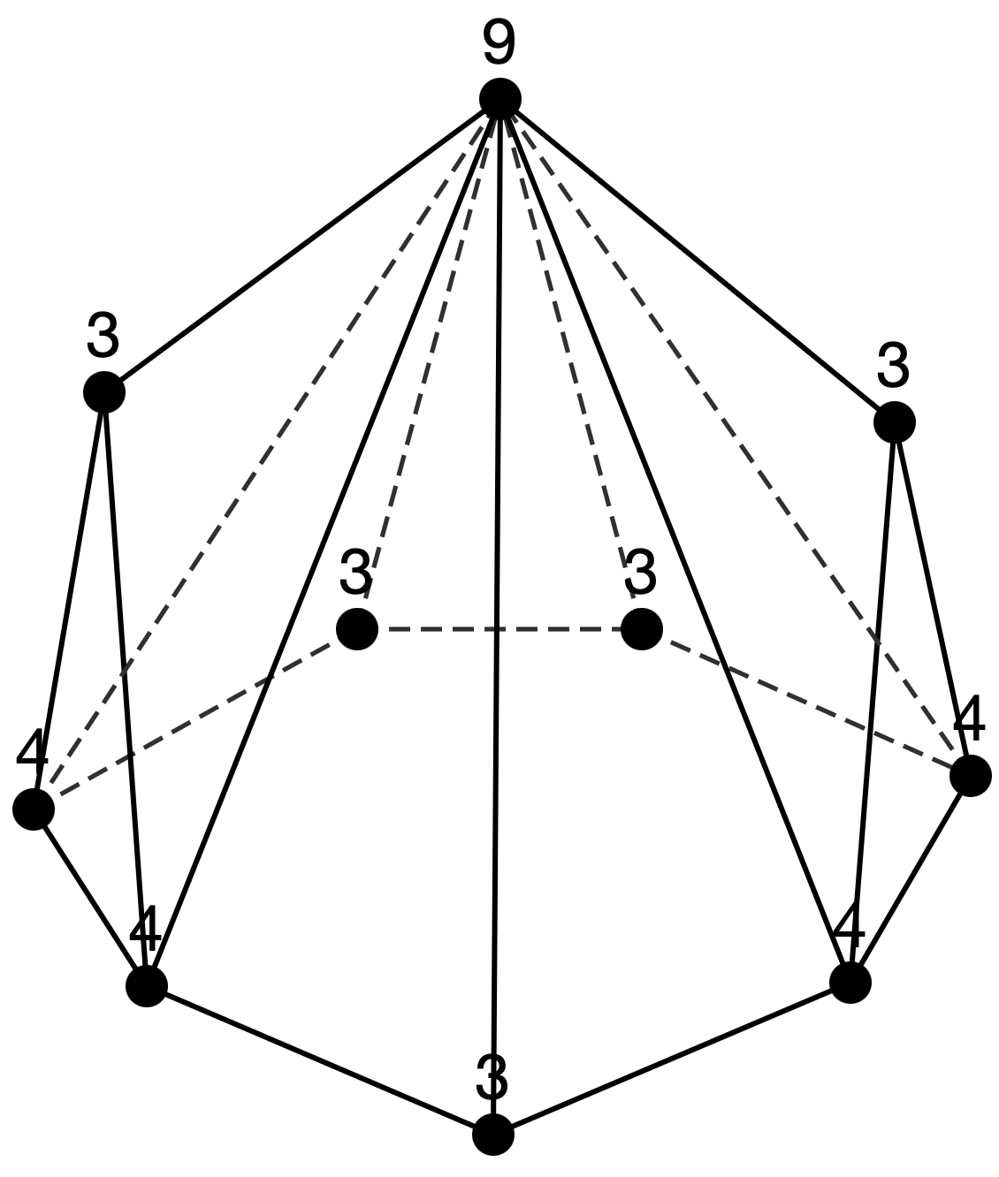
Sequence 6
n = 11 (14 types)
n = 10 (8 types)

Slide 9
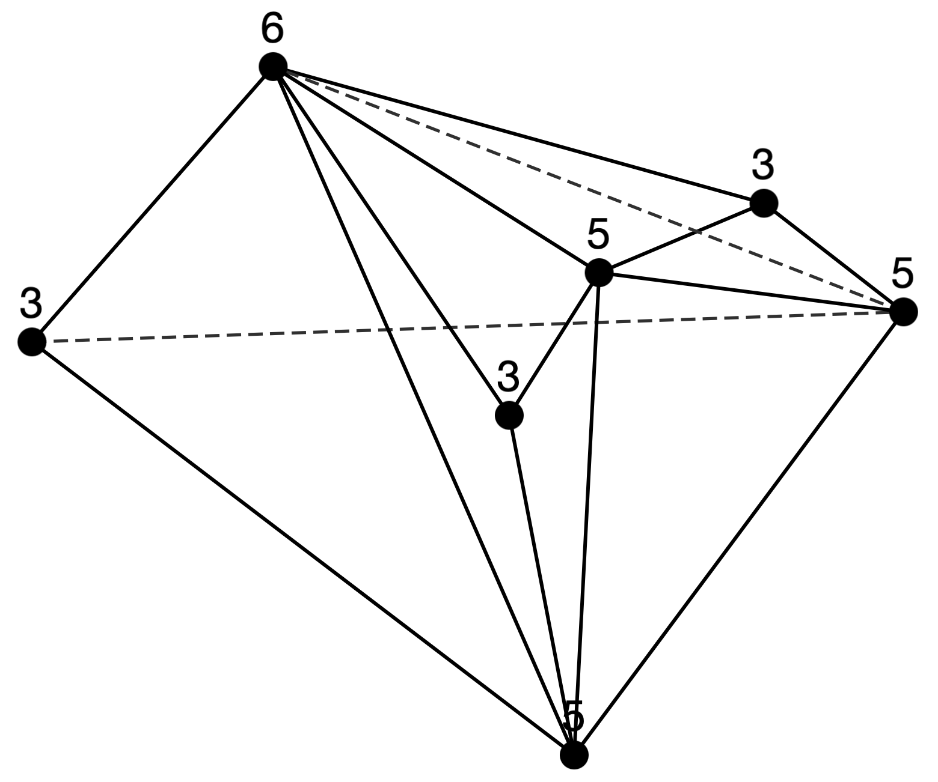
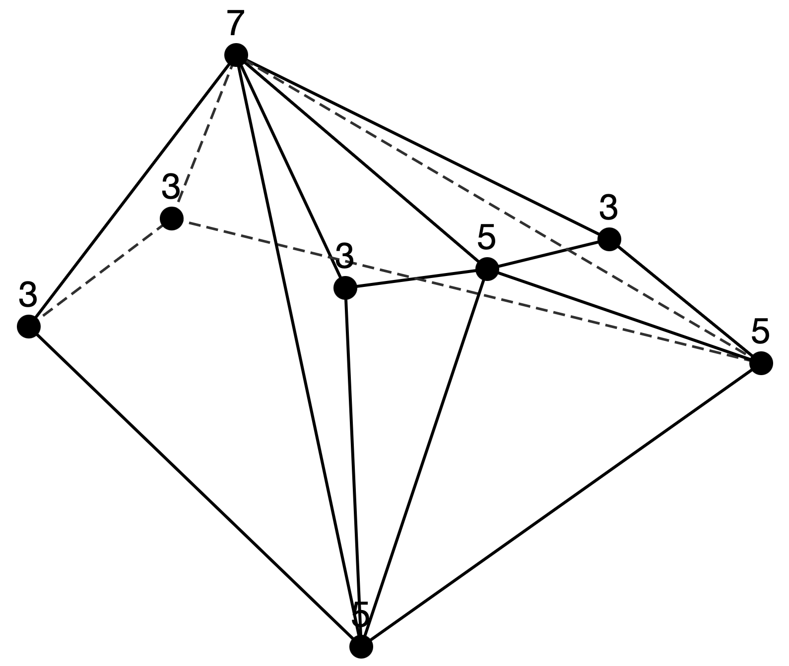
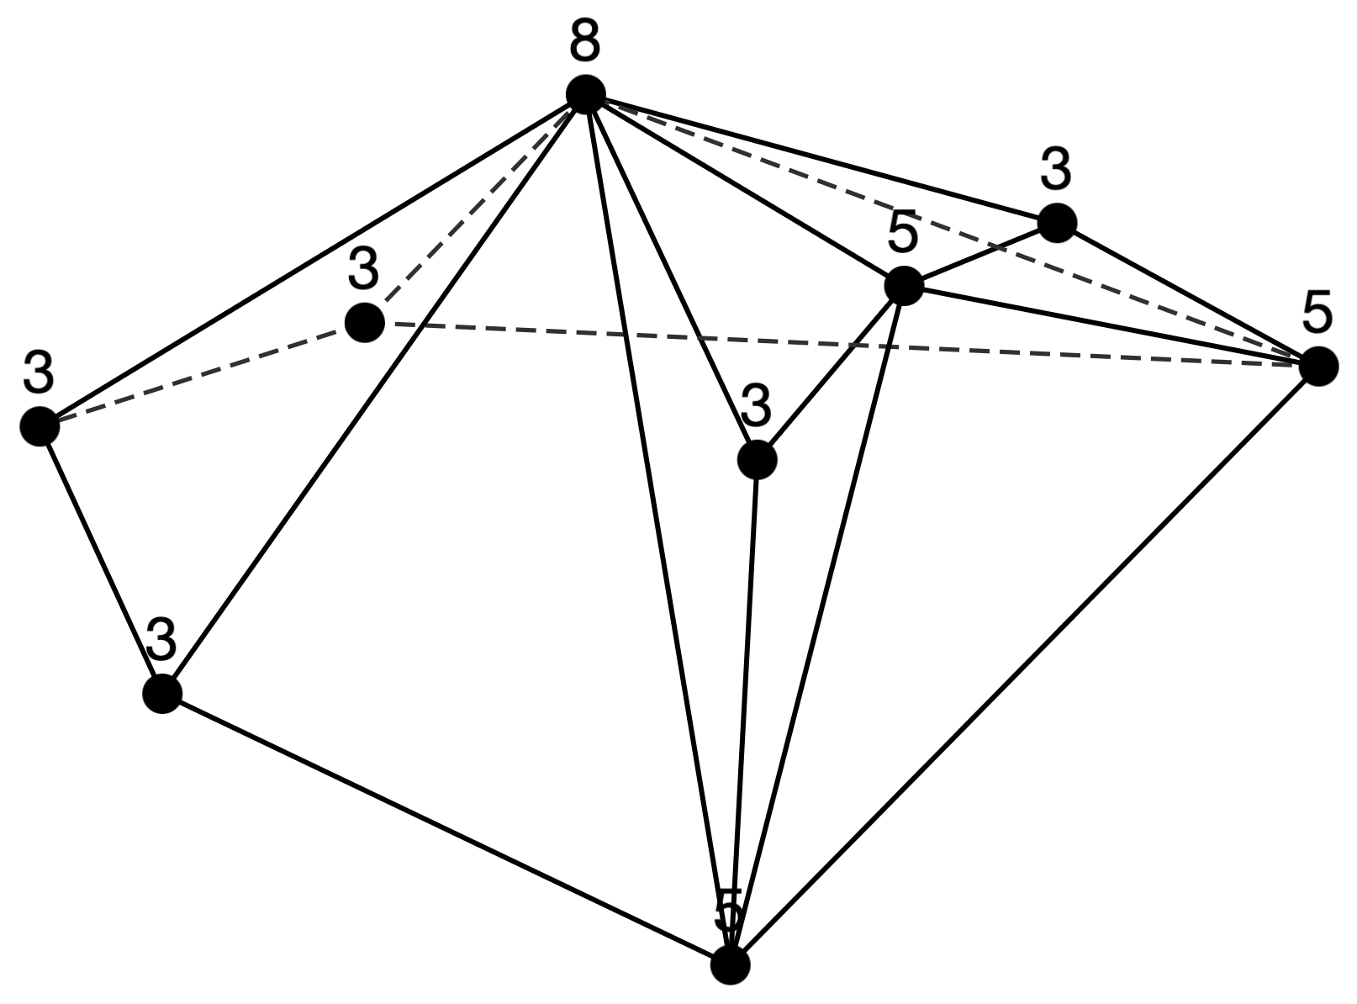
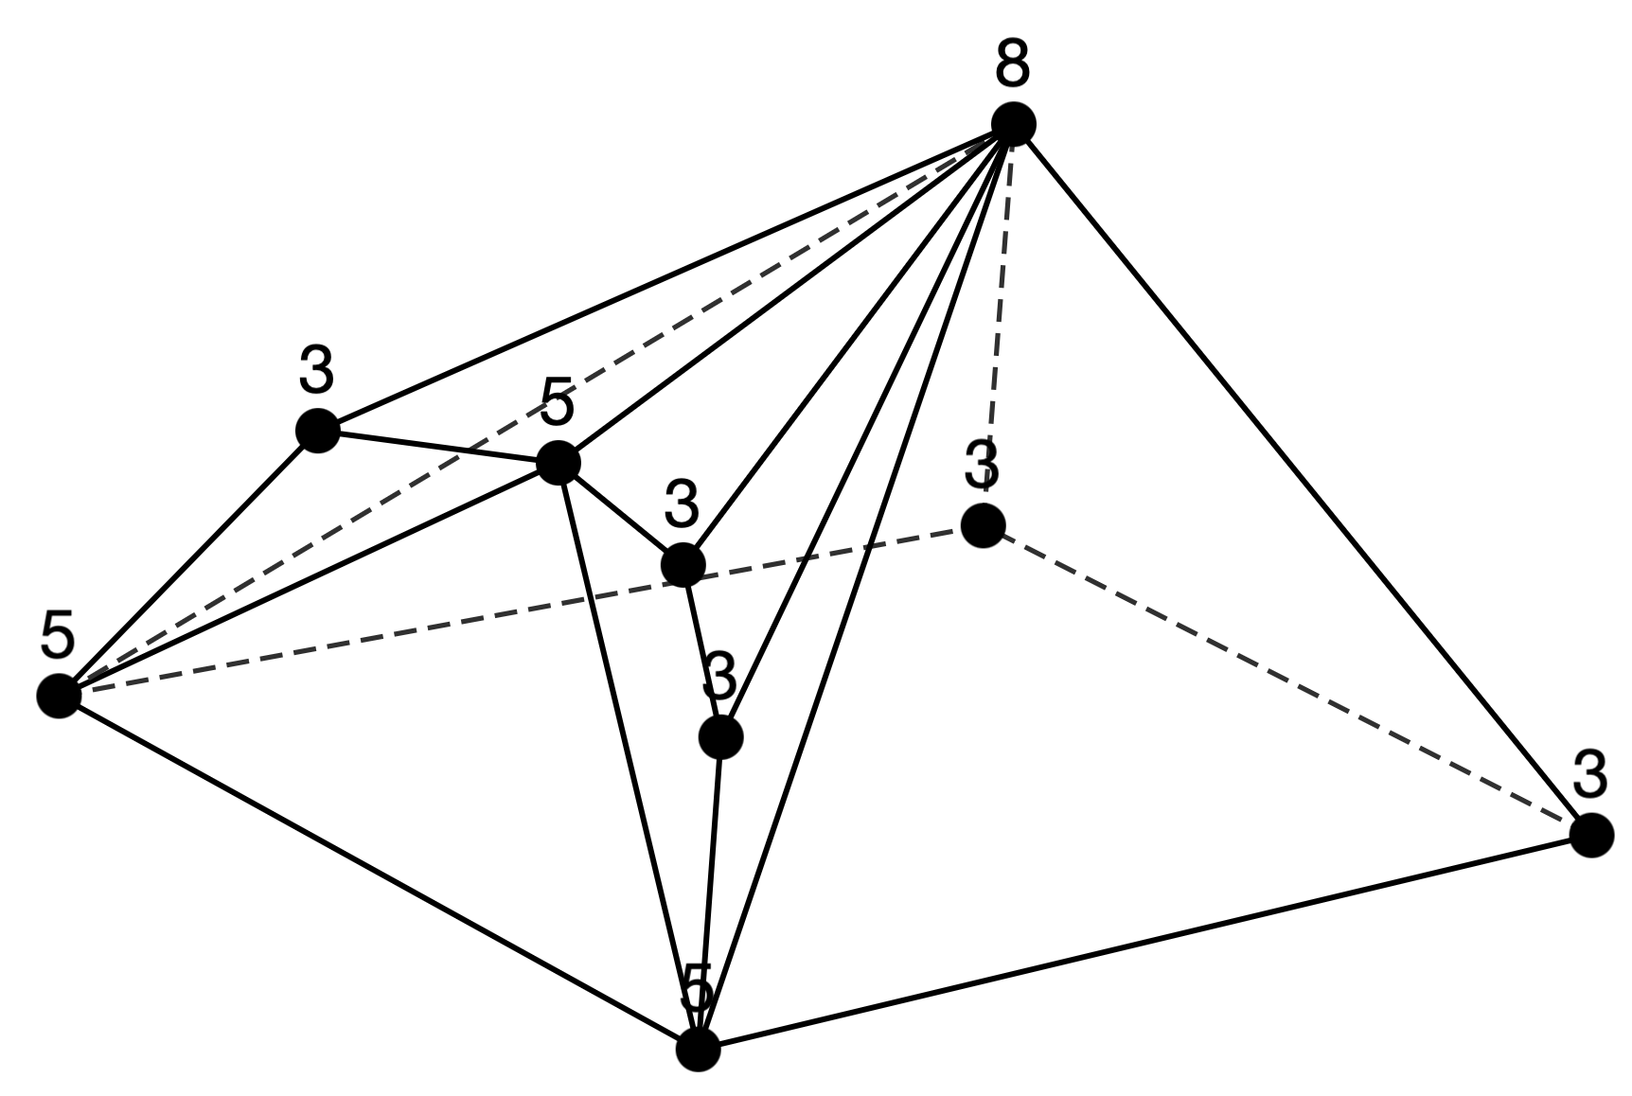
Sequence 7
n=7: [3,3][5,3][6,1]
n=8: [3,4][5,3][7,1]
n=9: [3,5][5,3][8,1]
n=10: [3,6][5,3][9,1]
n=11: [3,7][5,3][10,1]
n = 7 (1 type)
n = 8 (1 type)
n = 9 (2 types)

Slide 10
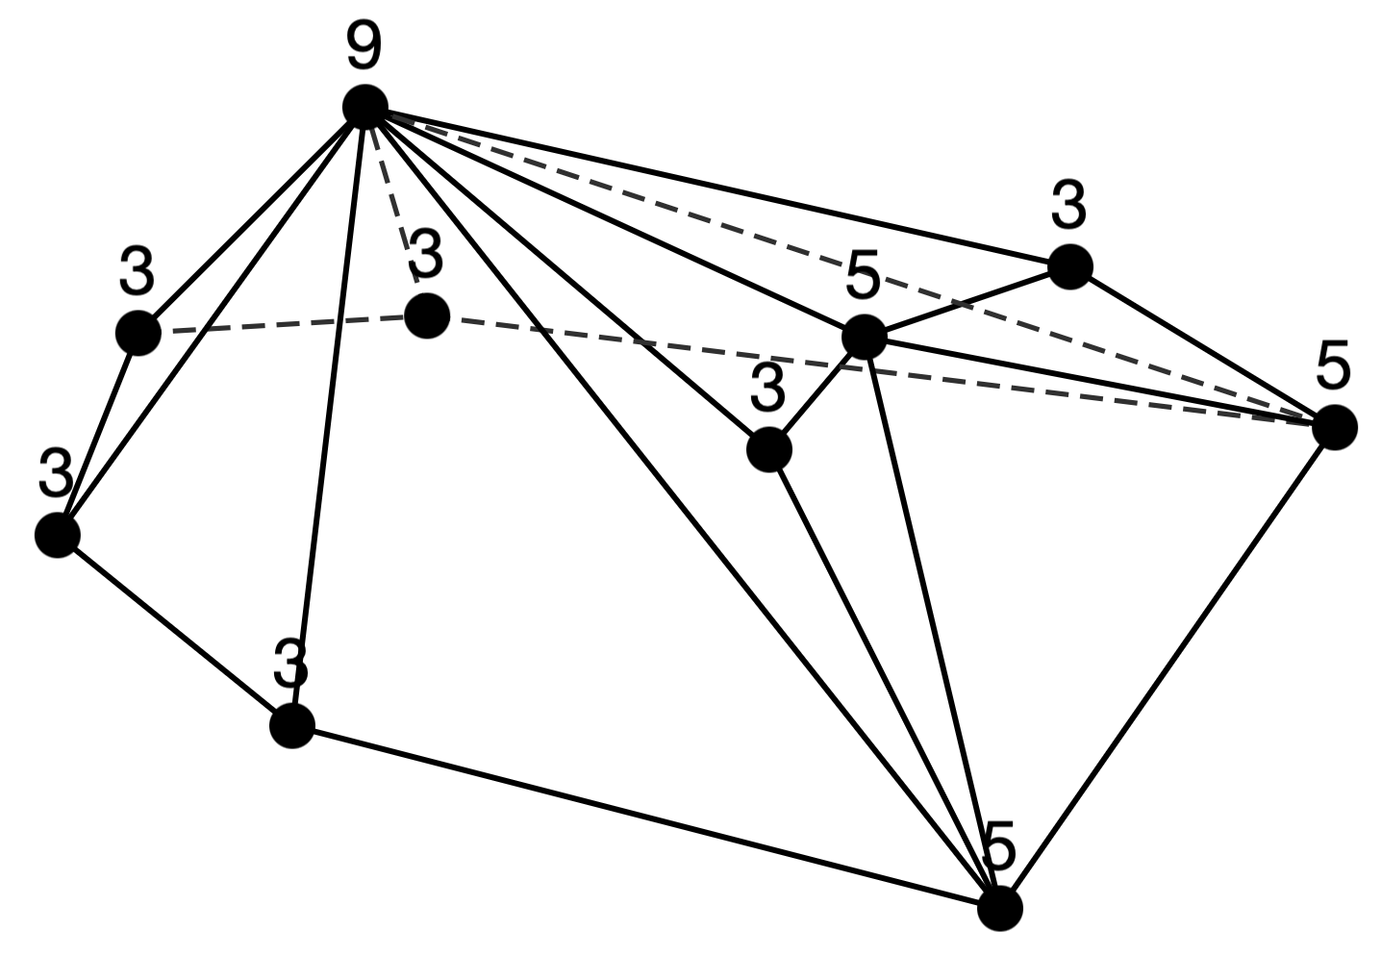
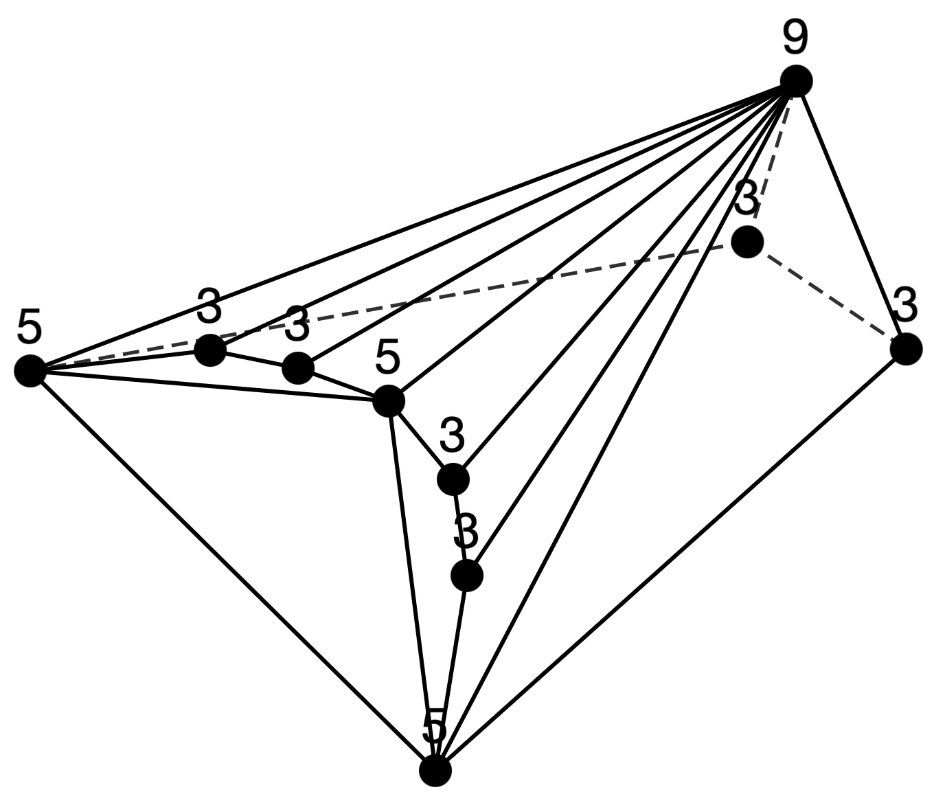
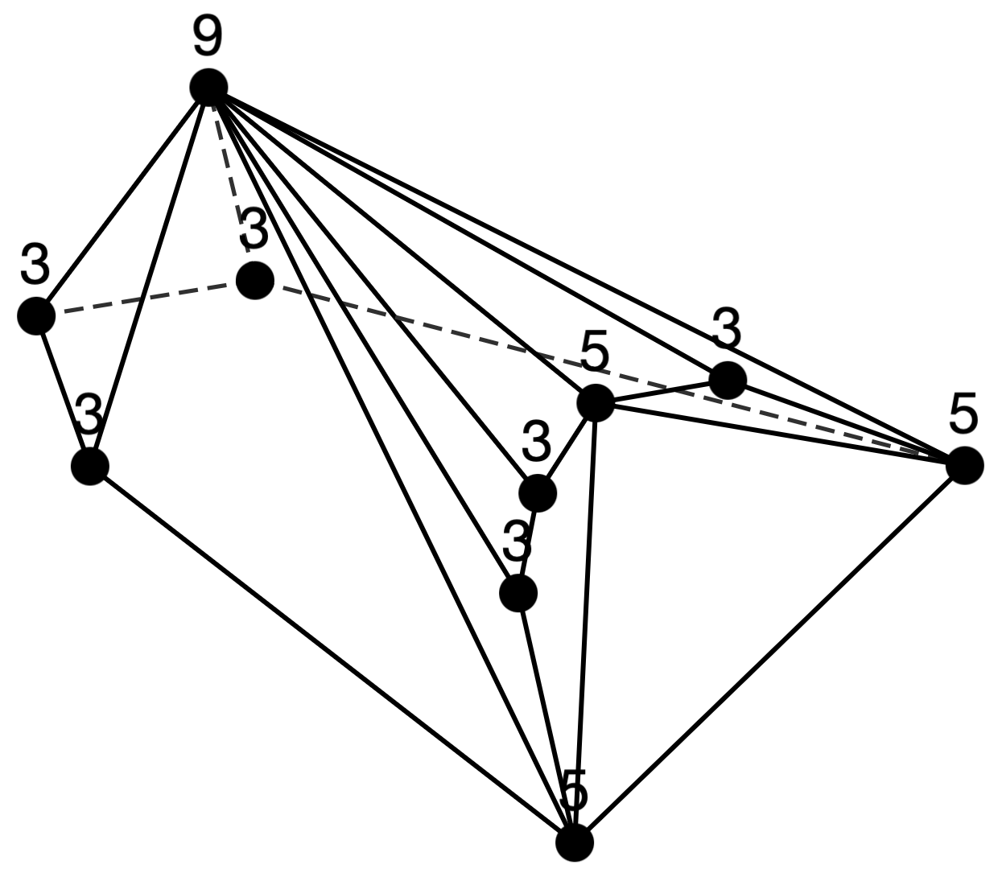
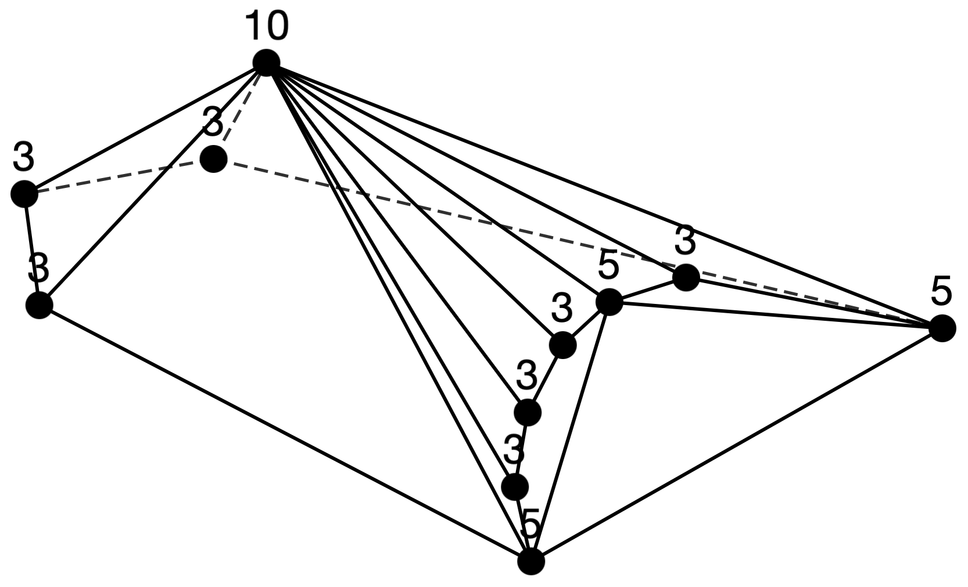
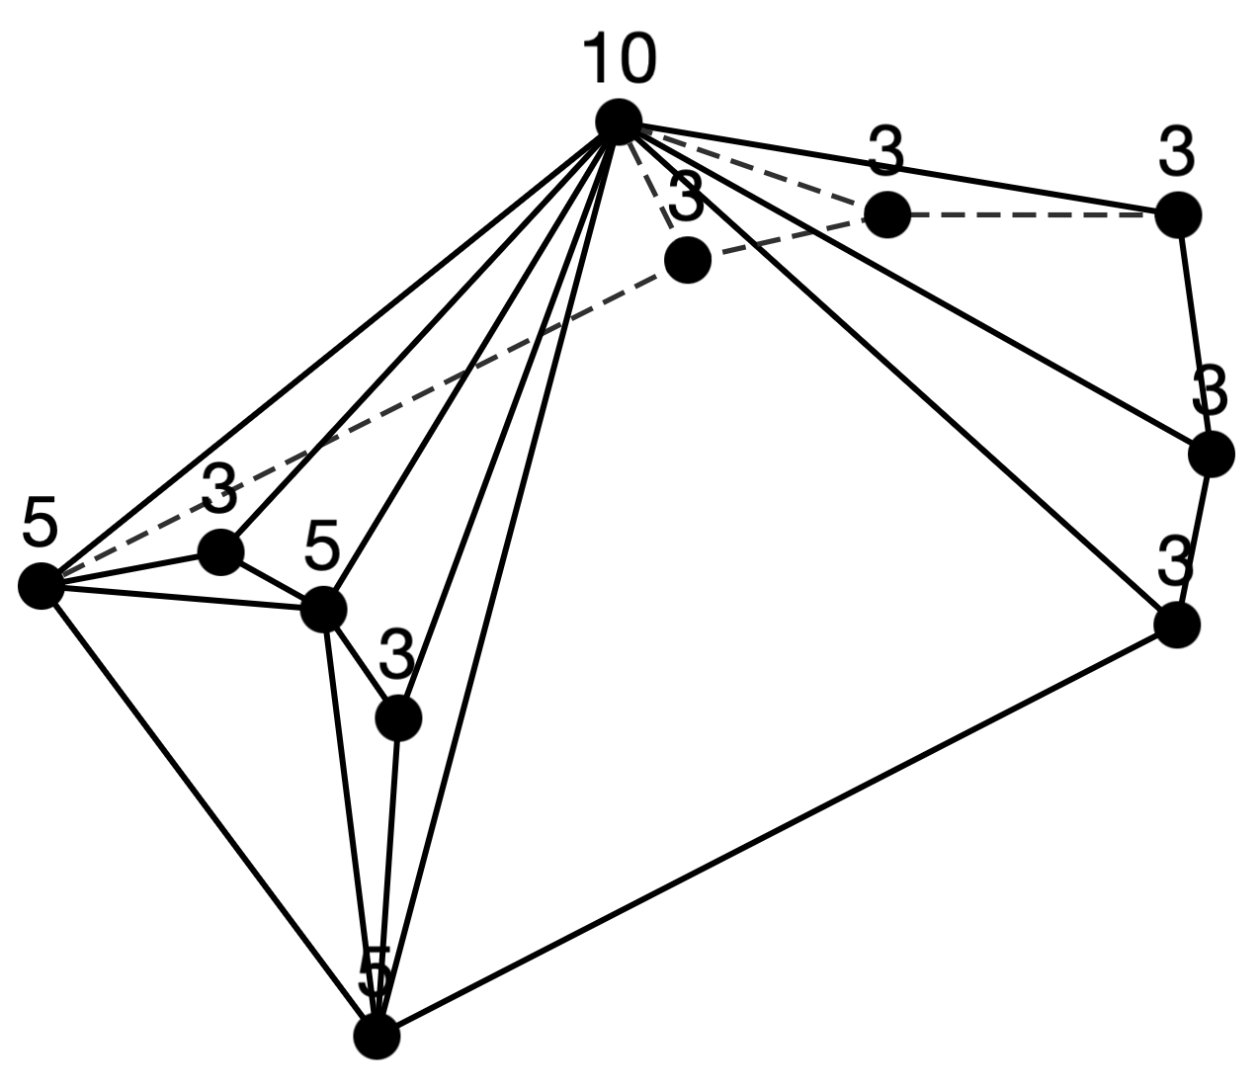
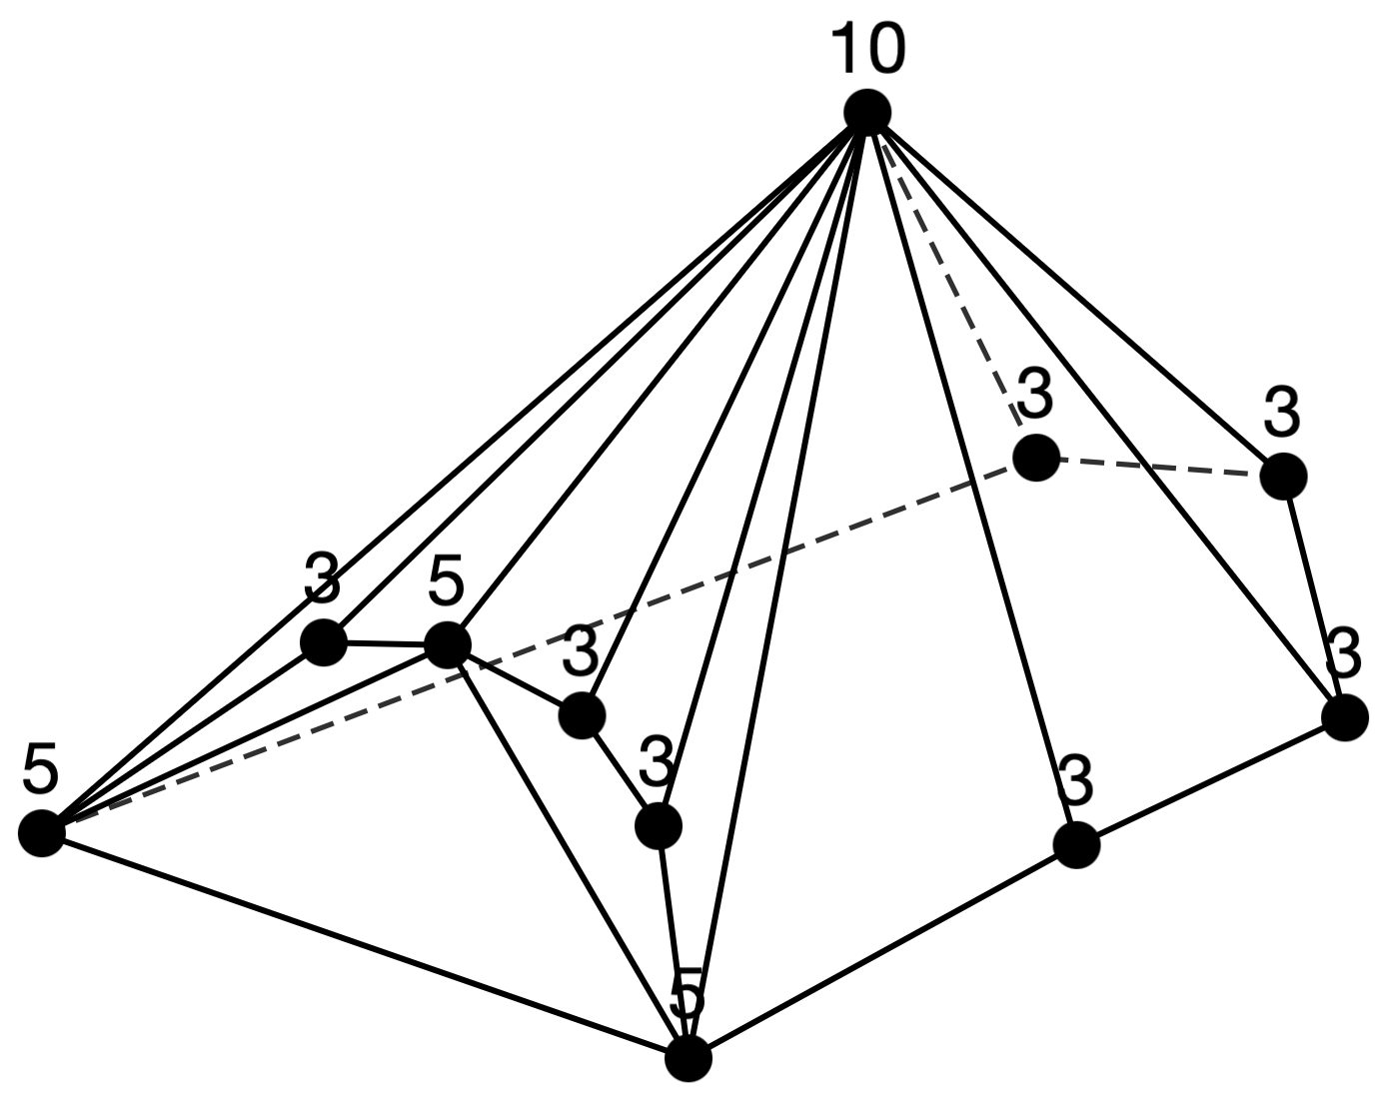
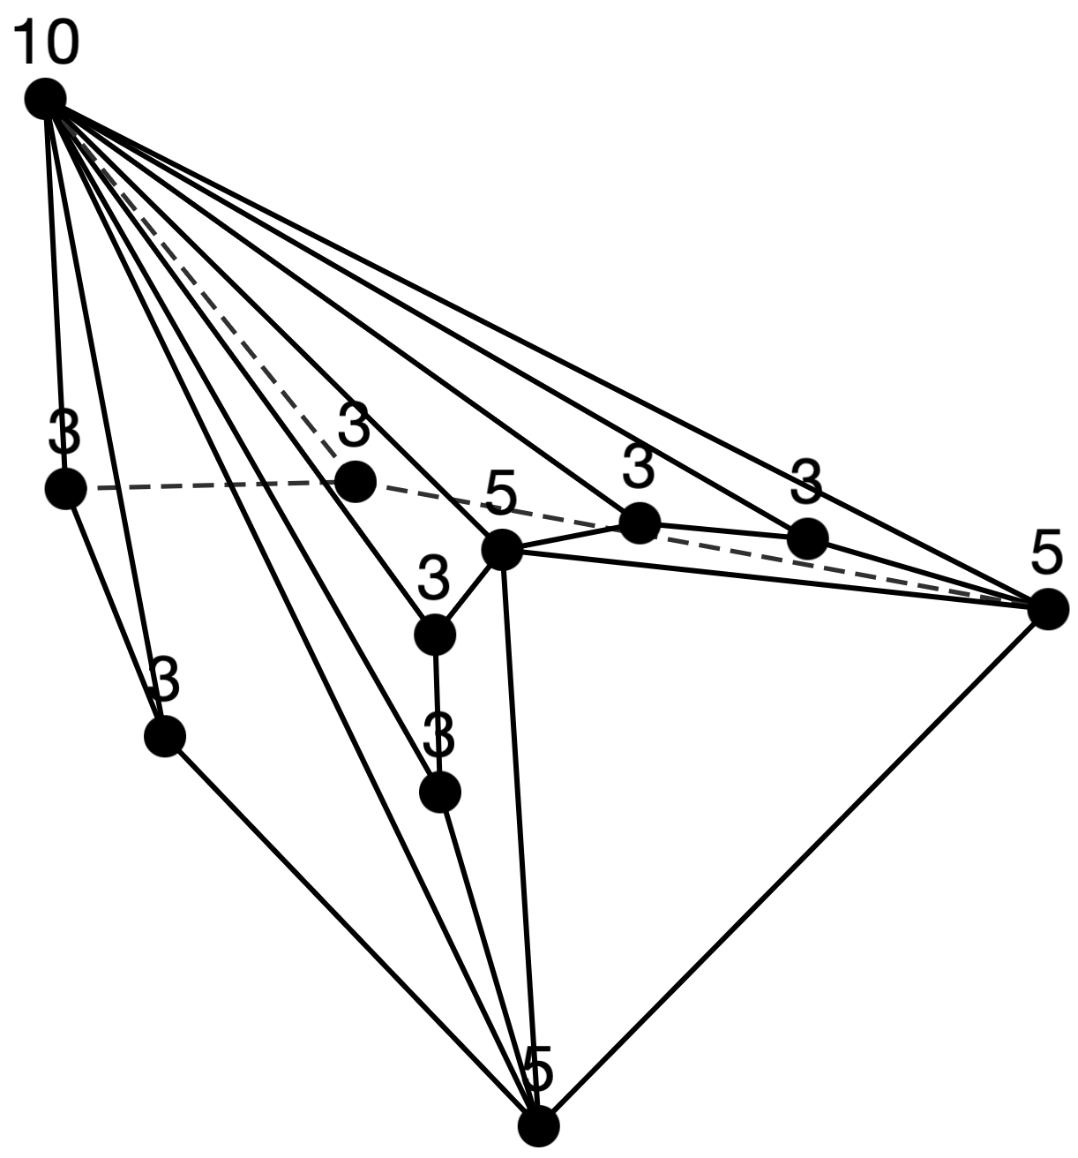
Sequence 7
n = 10 (3 types)
n = 11 (4 types)

Slide 11
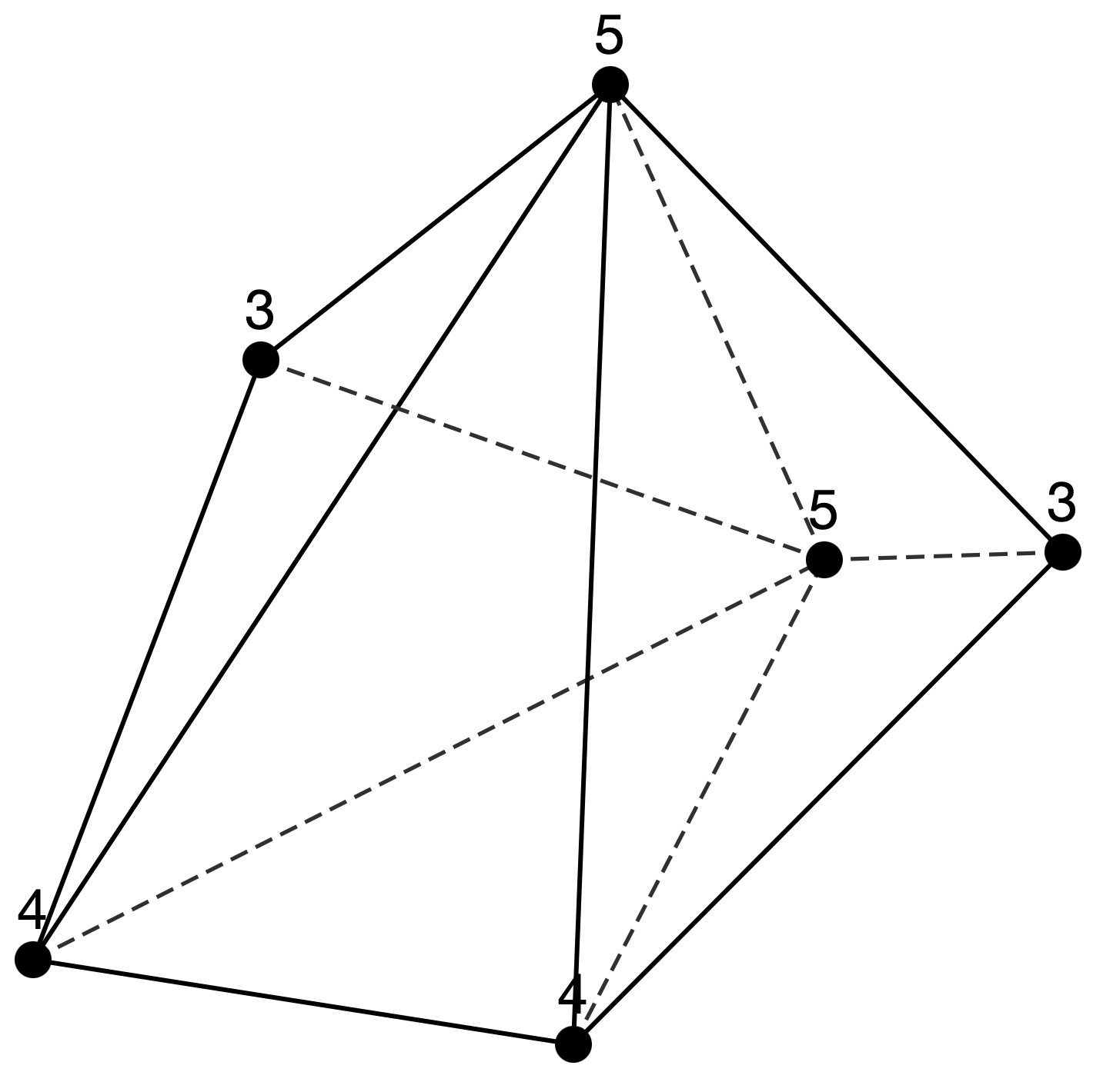
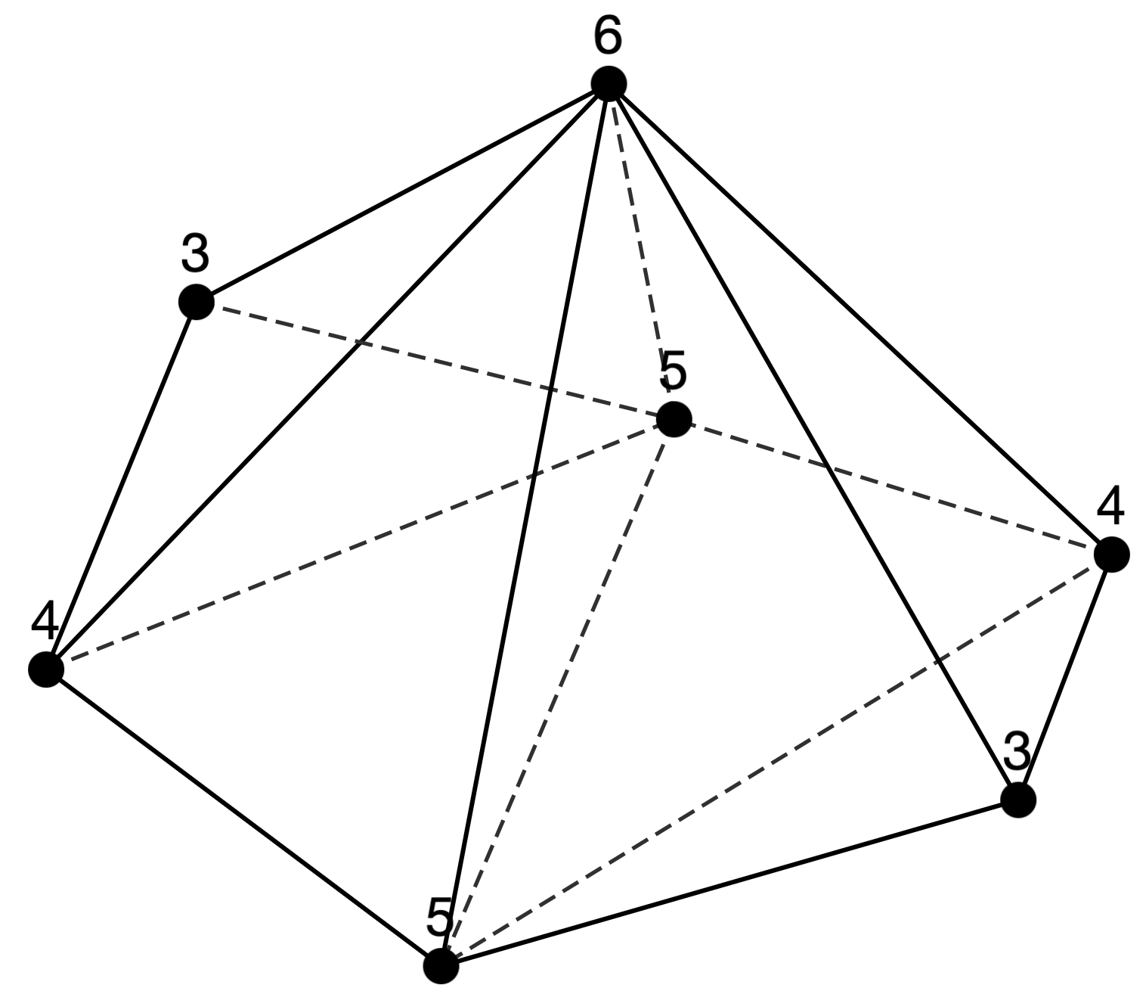
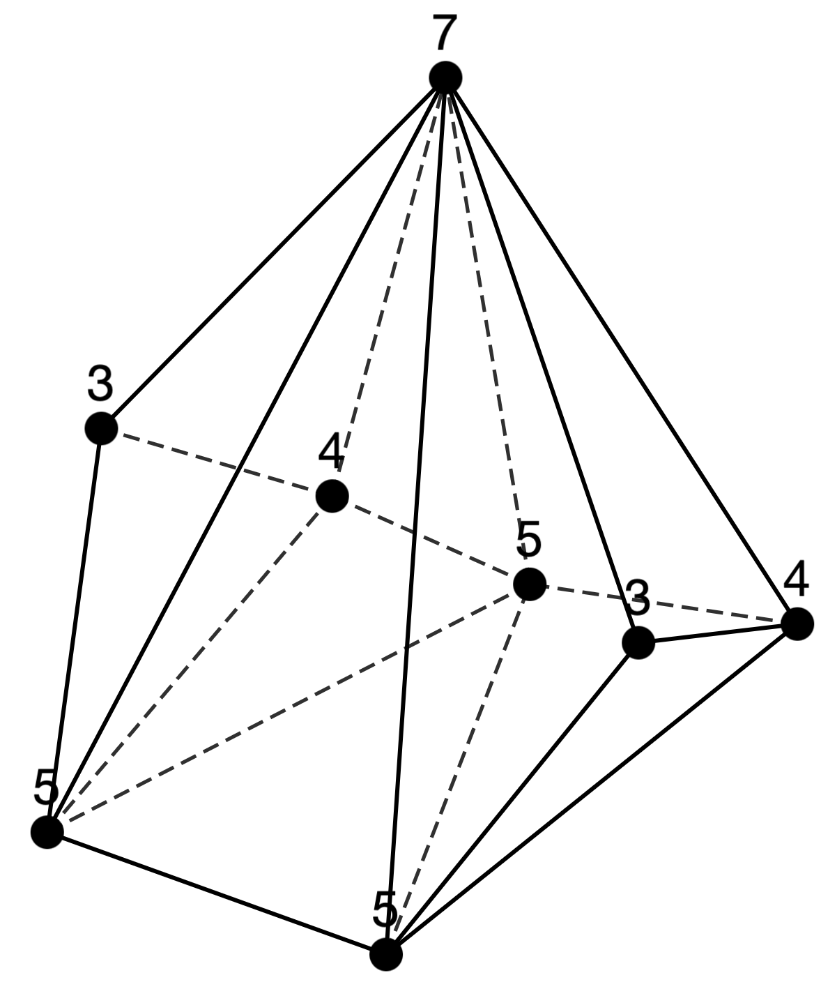
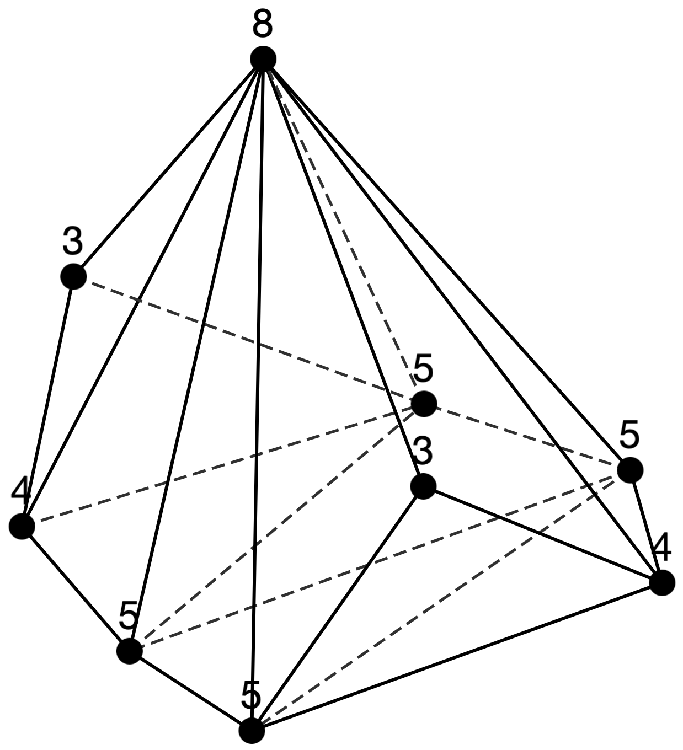
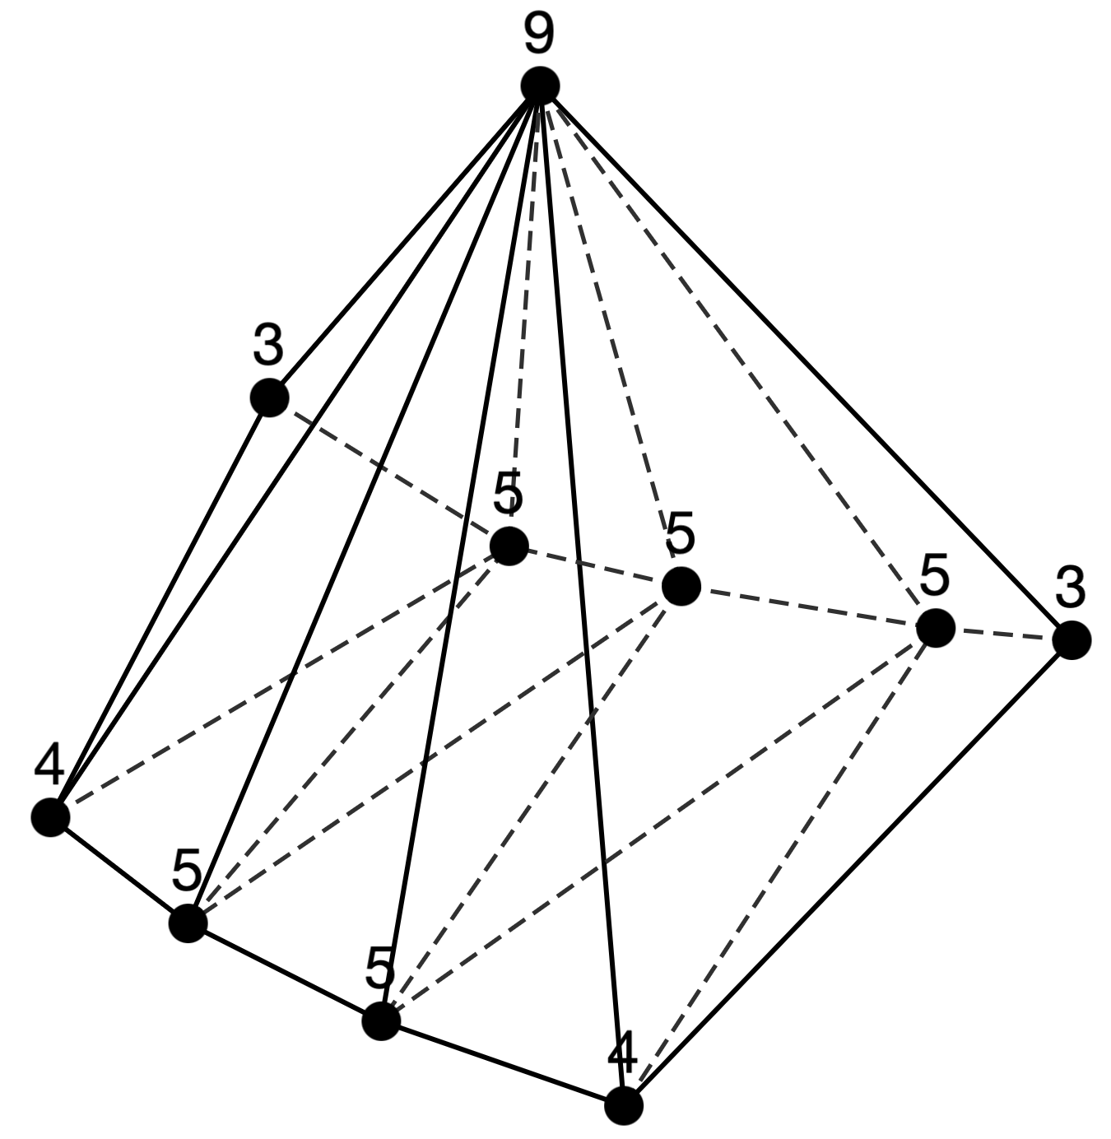
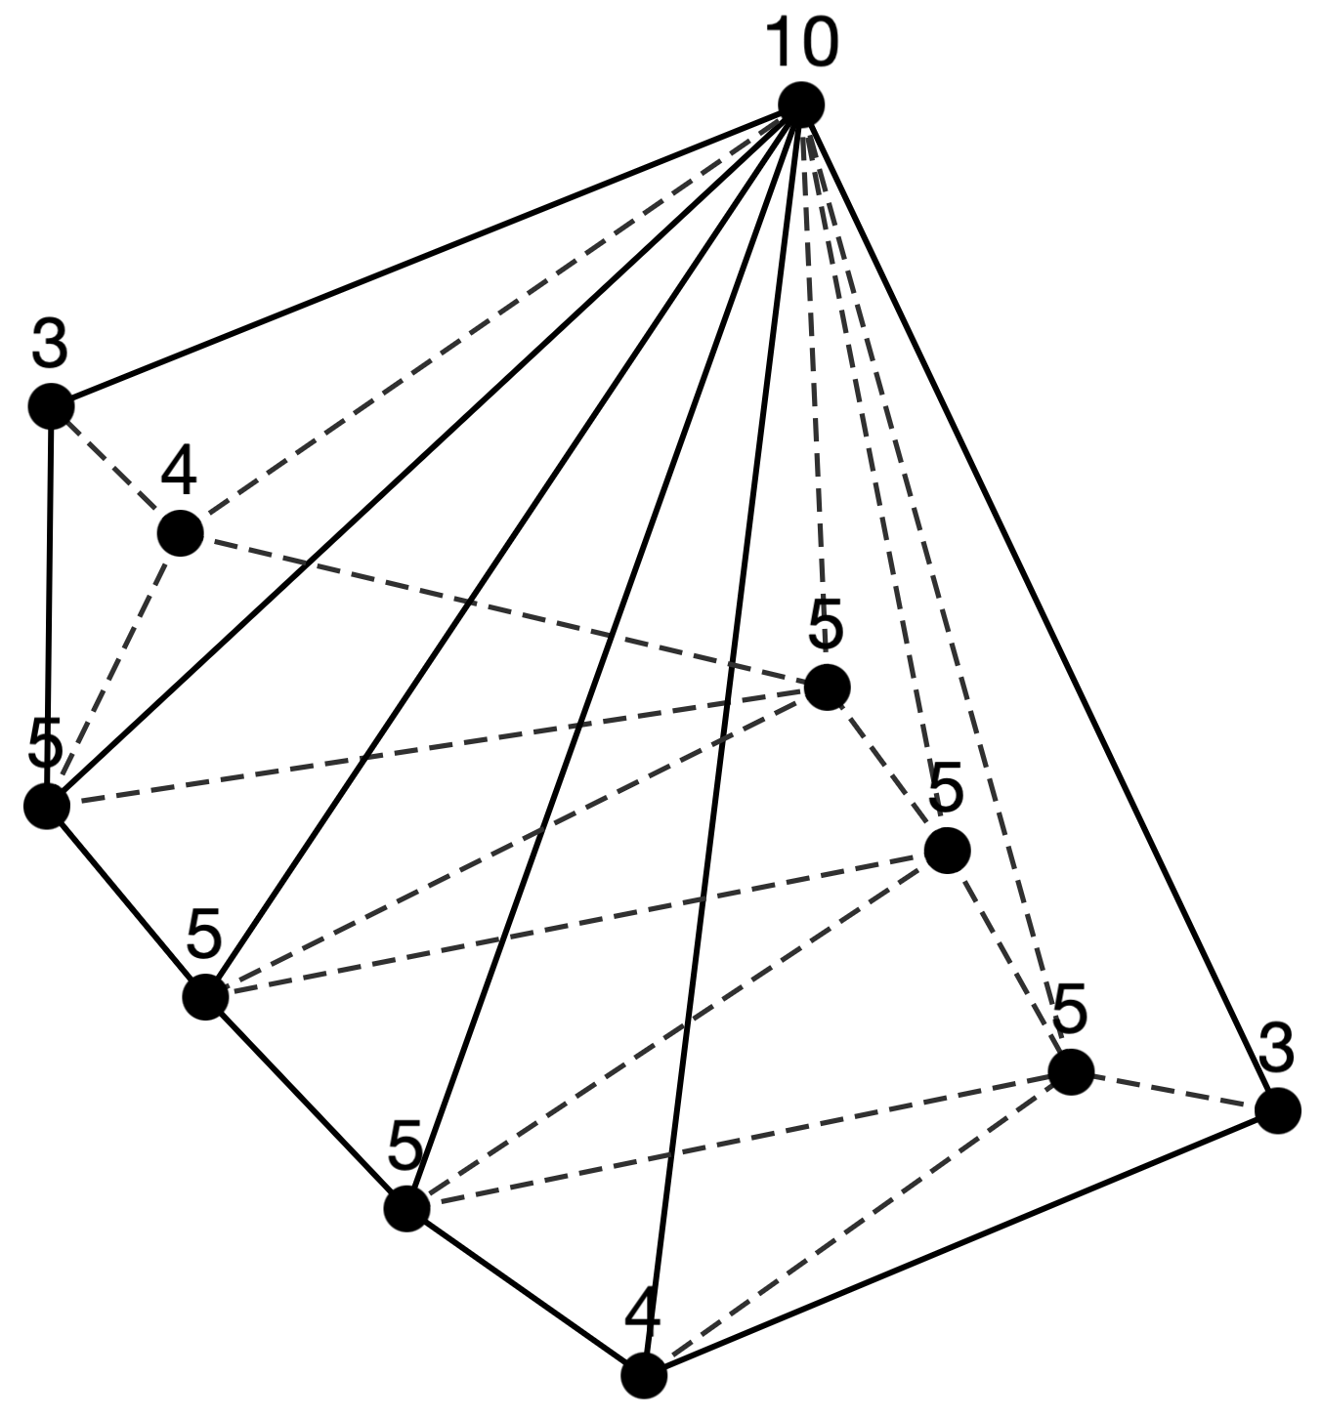
Sequence 8
n=6: [3,2][4,2][5,1][5,1]
n=7: [3,2][4,2][5,2][6,1]
n=8: [3,2][4,2][5,3][7,1]
n=9: [3,2][4,2][5,4][8,1]
n=10: [3,2][4,2][5,5][9,1]
n=11: [3,2][4,2][5,6][10,1]
n = 6 (1 type)
n = 7 (1 type)
n = 8 (1 type)
n = 9 (1 type)
n = 10 (1 type)
n = 11 (1 type)

Slide 12
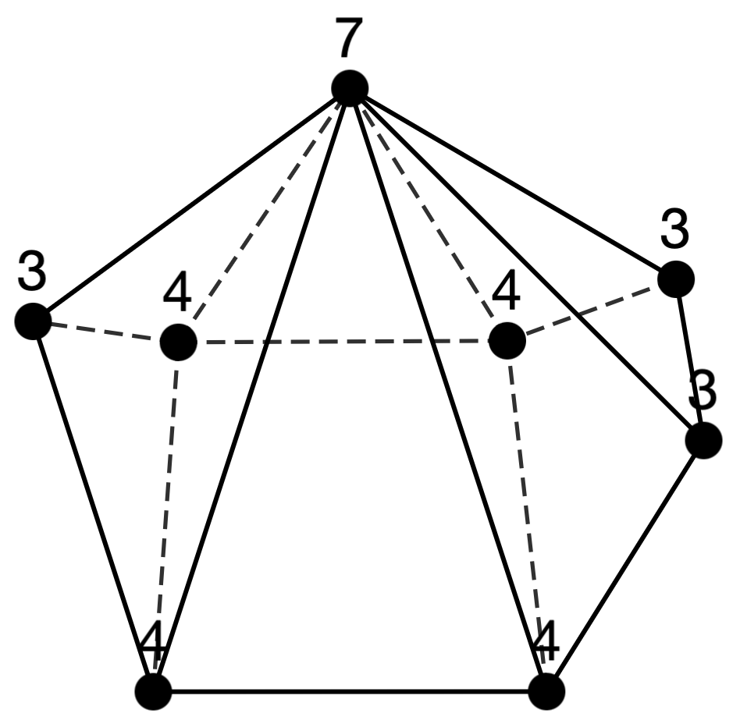
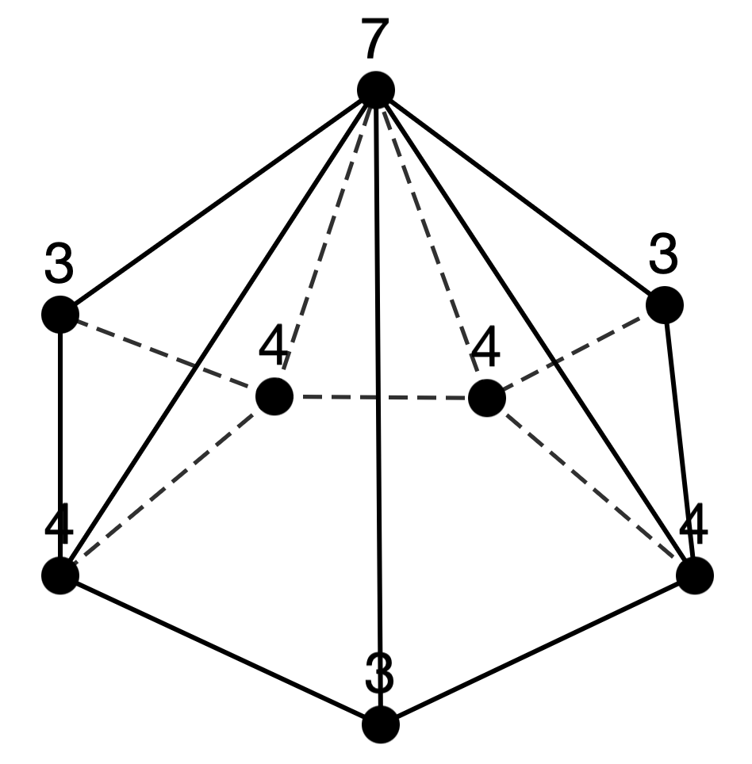
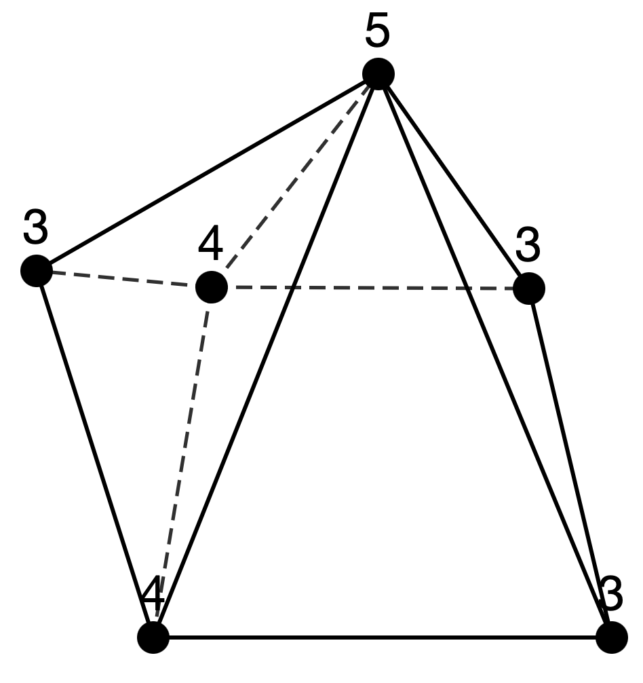
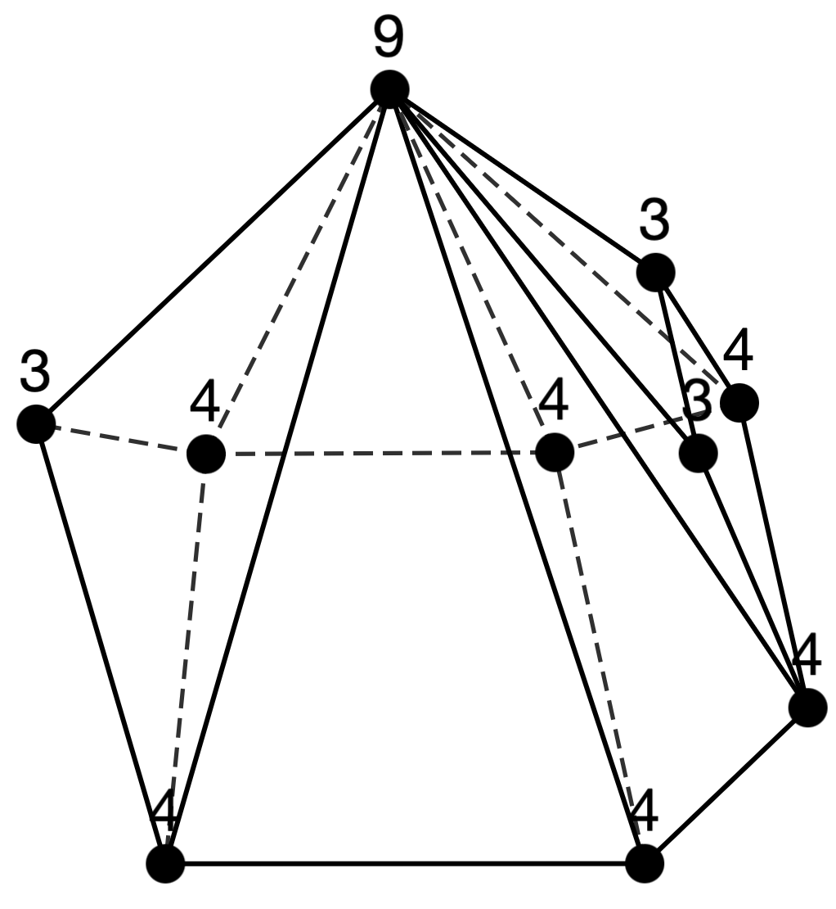
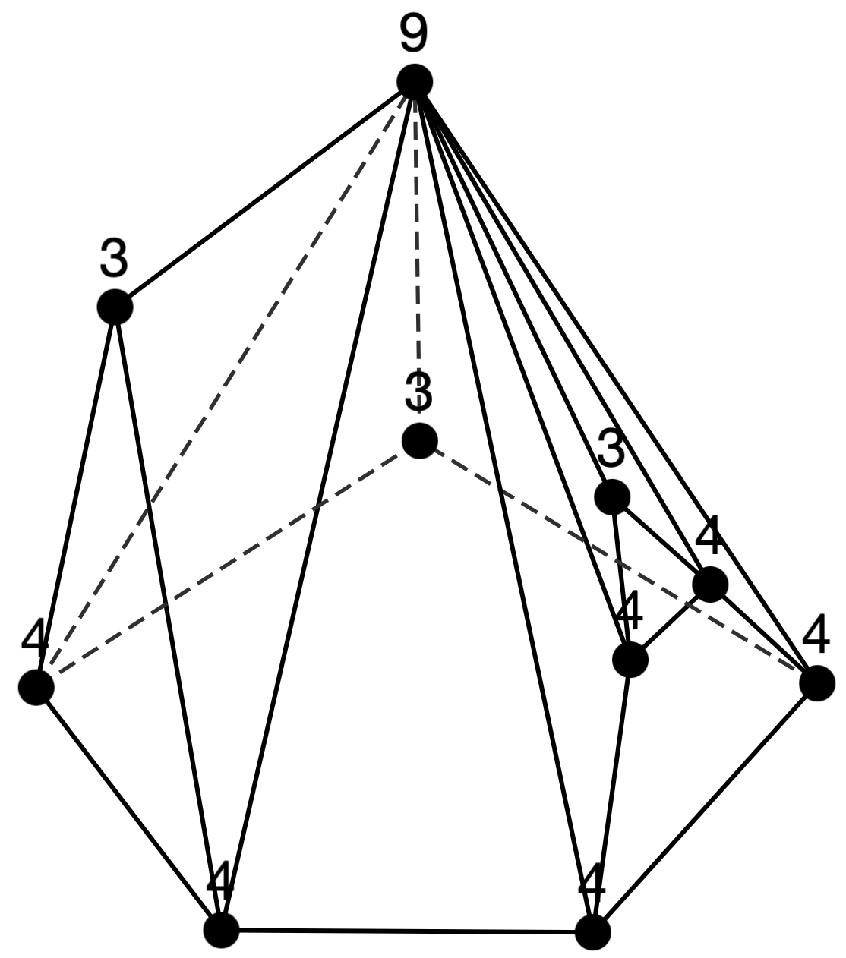
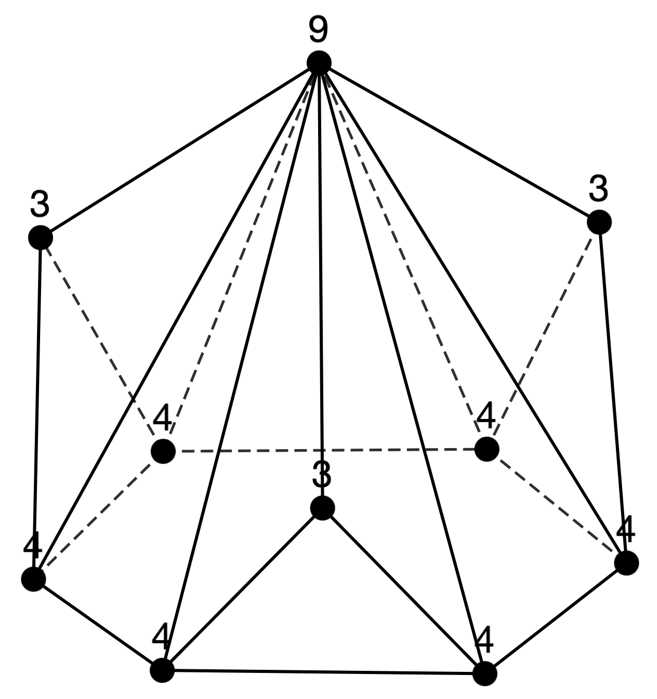
Sequence 24
n=6: [3,3][4,2][5,1]
n=8: [3,3][4,4][7,1]
n=10: [3,3][4,6][9,1]
n = 8 (2 types)
n = 6 (1 type)
n = 10 (3 types)

Slide 13
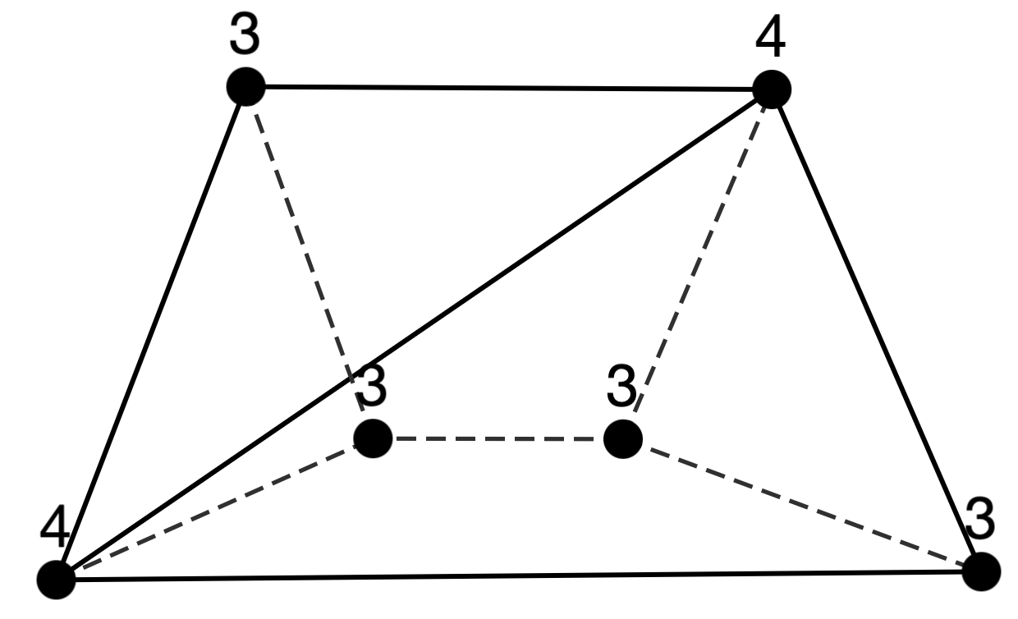
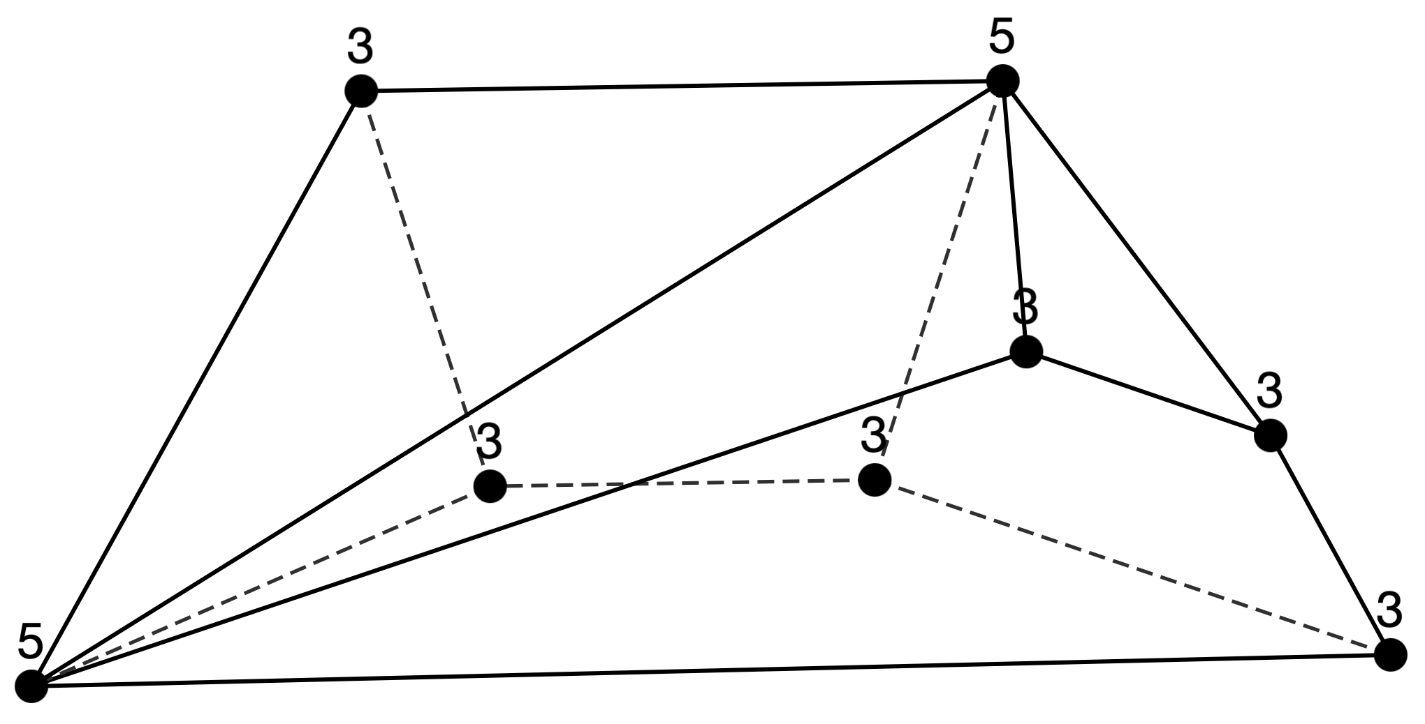
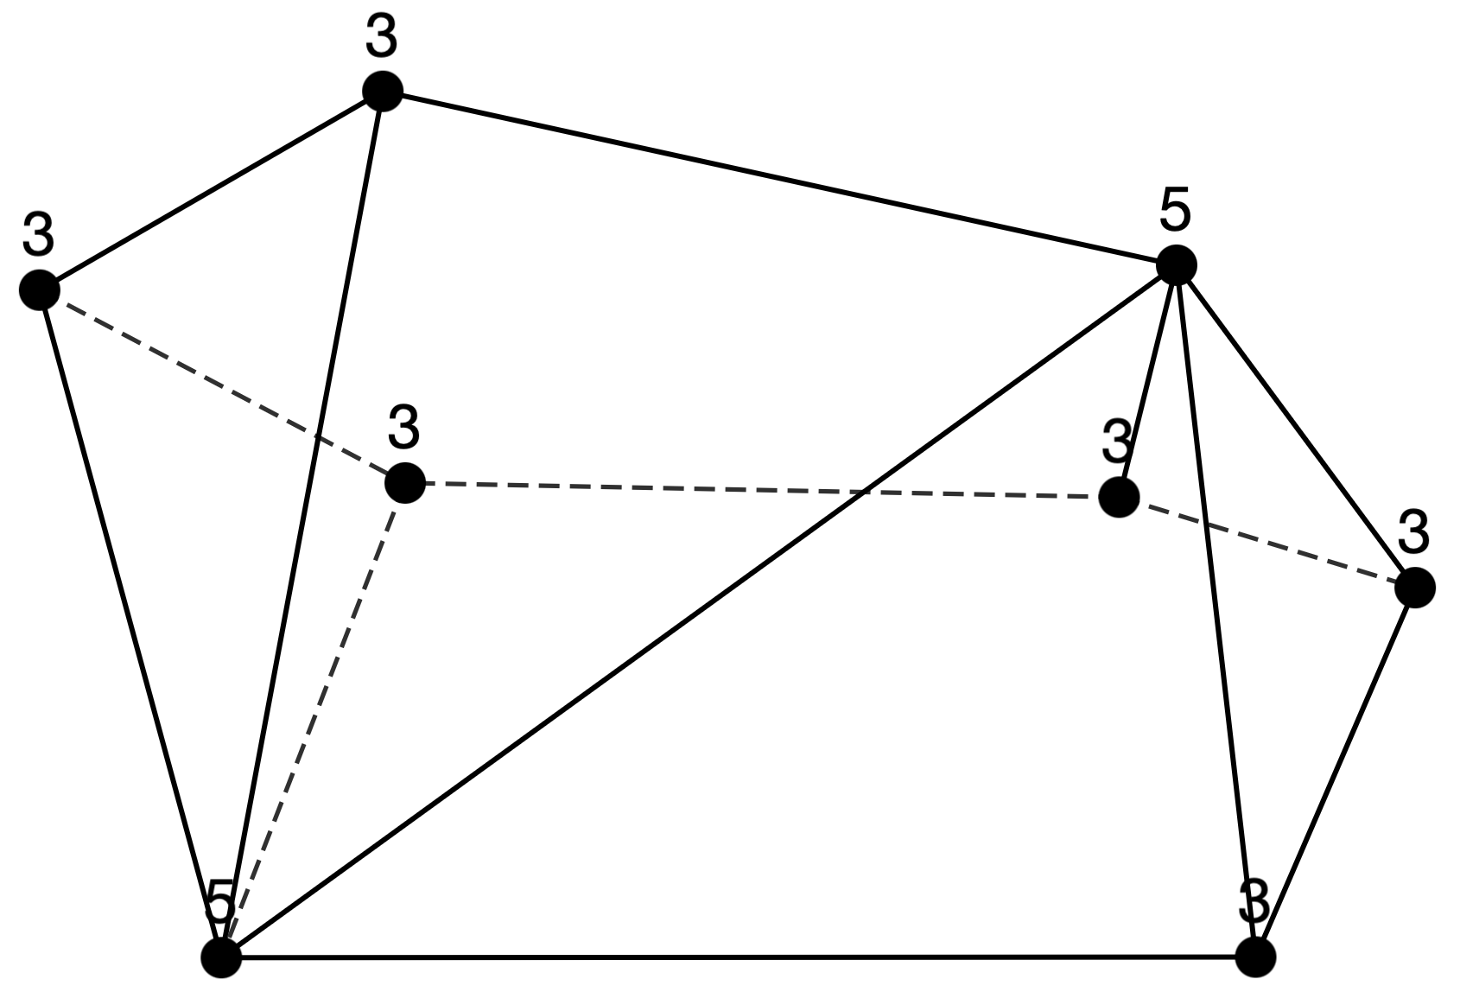
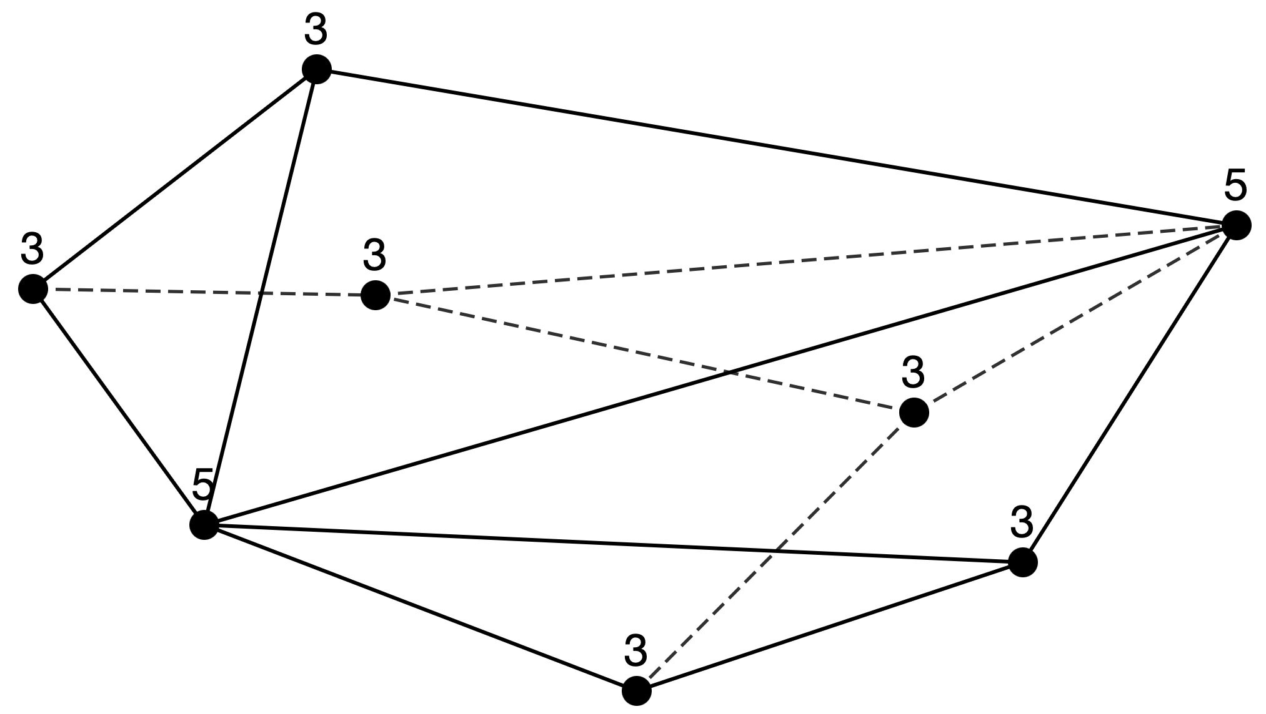
Sequence 25
n=6: [3,4][4,2]
n=8: [3,6][5,2]
n=10: [3,8][6,2]
n = 6 (1 type)
Not interesting …
n = 8 (3 types)

Slide 14
Points for discussion
Decide presentation title
Proposed Titles
Classification and Visualization of Polyhedral Graphs via Stepwise Structure Changes Based on Degree Sequences
Writing Schedule
Deadline: Monday, July 21
Share first draft on Overleaf by Monday, July 7
The slides will be prepared in Japanese.
Evaluation by the Host Researcher
Would it be possible for you to write it by next week.

